Slide 1
Macroscopic Muscle

Slide 2
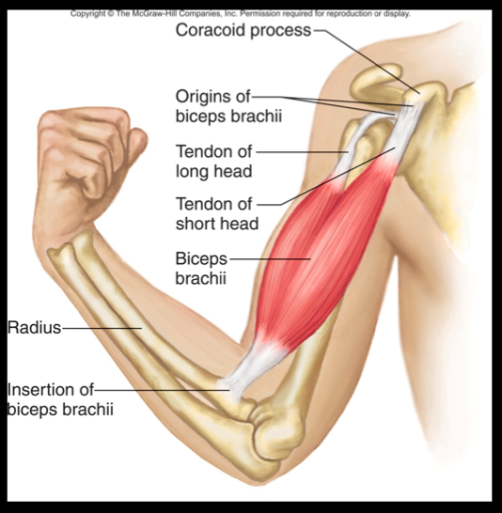
Macro

Slide 3
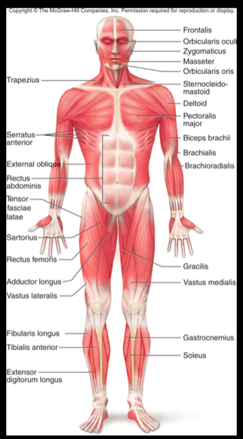
SternoClido Mastoid
Named for its Insertion and Origin

Slide 4
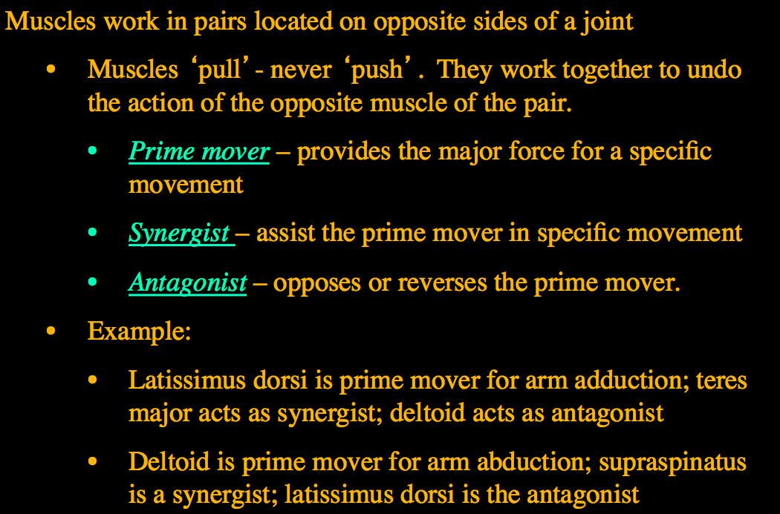

Slide 5
Pick a Muscle and Find:
Identify the movement
Demonstrate to class
Prime Mover
Synergist
Antagonist

Slide 6
Muscle Stimulator
The Claw hand challenge

