Slide 1
3D DNA MODEL

Slide 2
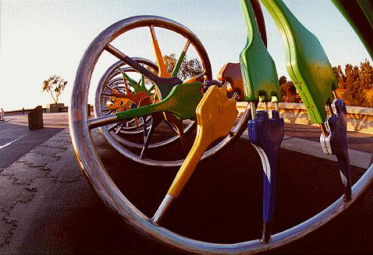
The outdoor DNA model at the Lawrence Hall of Science

Slide 3
DNA model made of ice at the 2009 World Ice Art Champion-ships, Fairbanks Alaska

Slide 5
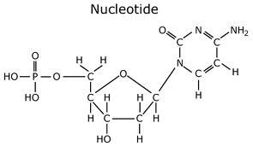
Nucleotide Elements
Take out your DNA coloring sheet and label

Slide 6
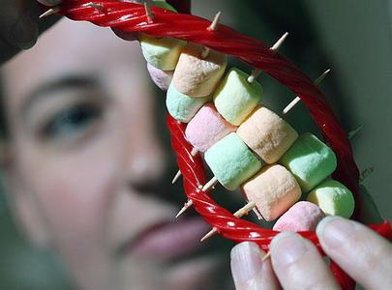
Guidelines for DNA Model Group:
You will work in groups of 2 - 3.
Group points depend on individuals using class time efficiently.
You will point-divide.

Slide 7
Due dates for DNA Model:
Stage 1 Design: Make a detailed & labeled drawing of your model.
Due: Fri - 4/20 (8pts)
Stage 2: One Prototype Base Pair: Build one A-T base pair, attached by hydrogen bonds.
Due: Mon - 4/23 (12 points)
Stage 3: Make the subunits: Bring the nucleotides to class on
Due: Weds - 4/25 (15 points)
Stage 4: Assemble the model: – BRING ALL MATERIALS FOR MODEL AND KEY. Assembly day will be on
Due: Fri - 4/27 (15 points)
Stage 5: The final model: Hand this in on
Due: Mon - 4/30 (55 points)

Slide 8
DNA Model: RIGHT NOW
FIND YOUR TEAM
Trade contact information
Popcorn read the WHOLE Assignment sheet
Make a plan
Use the remaining part of the period to plan work times, supplies, a to do list and write down all important dates

