Slide 1
Warm-Up 5/16
What are the possible pros and cons of this?

Slide 2
P. Glow Lab
Zannie Dallara

Slide 3
Groups
Team #1 | 2 | 3 | 4 | 5
Oscar Elsa Jack Ali | Nathaniel Mario Patric Isabel | Dwight Jabari Kendall Na-osha | Osmand Gage Simone Ryan James | Rhinanon Austin Meaghan Eamon

Slide 4
VOCAB
GE: genetic engineering - alteration of the structure of genetic material in a living organism. It involves the production and use of recombinant DNA and has been employed to create bacteria that synthesize insulin and other human proteins.
Trait: A genetically determined characteristic or condition:
PPM/PPB: Parts per million/ parts per billion
Plasmid: (PLAZ mid) - a genetic structure that can replicate independently of the main chromosome(s) of a cell; usually, a circular DNA molecule in bacteria ( prokaryotes).
Herbicide | Insecticide
Herb: Plant | Insect: bug

Slide 5
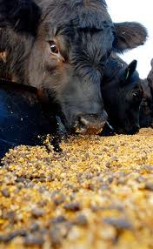
Genetic Engineering
Uses: Industrial
Yeast used to make blood sugar
How:
Effect Traits (vocab)
Example:
Increase muscle in a cow
Insect resistance in plants
BT Corn and round up ready corn

Slide 6
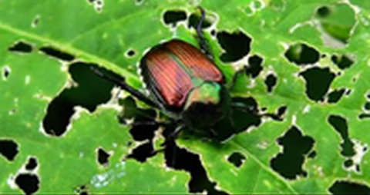
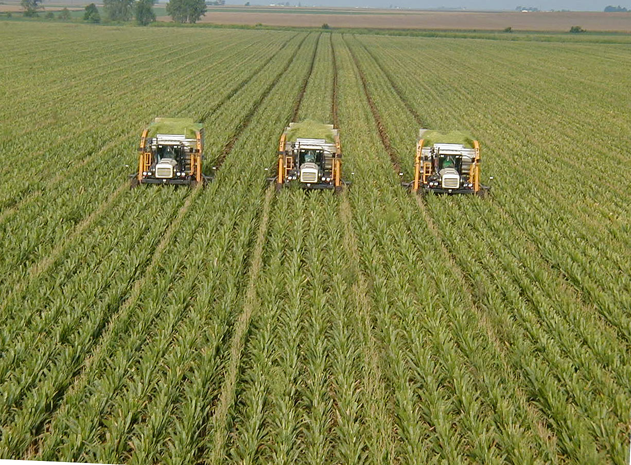
Genetic Engineering Crops
Monoculture

Slide 7
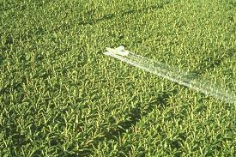
Genetic Engineering Crops
Monoculture
How do you apply insecticide?
Spray on
Or GE insecticide into Plants = BT Corn
Safe levels – what about over life time?
How about herbicide? Same process as insecticide
Round Up ready corn
PPM/PPB

Slide 8
PPM/PPB Video
Add video Link

Slide 9
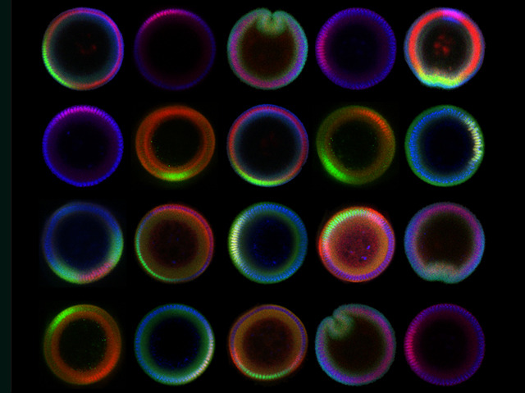
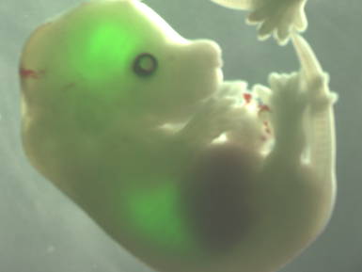
Genetic Engineering Why
Drosophila (fruit fly) embryos
An early developing mouse embryo
Takes time to see if gene works
Grow plant
Give bugs access
See if bugs die
Don’t Want to Wait Years?
Add a visible gene!
Track development

Slide 10
Jobs and Education
BioRad™ engineers these DNA segments for sale
2 year degree: Tech
4 year degree: Scientist
Masters/PhD: Project manager
PIC OF Scientists

Slide 11
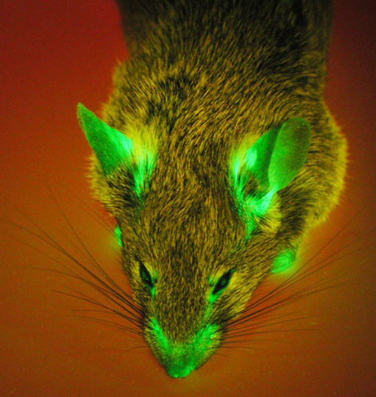
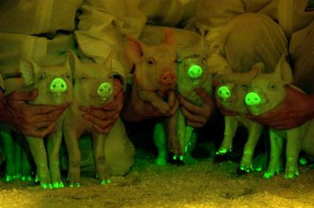
Genetic Engineering Process
It Works!
Glow
Make gene glow and add with desired gene
You can see if gene integrated successfully in embryo

Slide 12
Genetic Engineering How – Today’s Lab
Overview

Slide 13
Goal
Outcome: Understand how tools and techniques are used I biotechnology to further our understanding of vertebrate evolution and discuss some applications of genetic engineering.
Indicator: Discuss the social impacts of biotechnology (Pros and Cons).
Focus Question: How do we use biotechnology to further our understanding of vertebrate evolution?
Discuss different plates and components function
Create hypotheses about what grows and glows?

Slide 14
Lab Write-Up and Hypotheses
Organization/Components/Rubric for grading
Hypothesis worksheet
Don’t have to be right
For each plate write a paragraph describing:
Your hypothesis
Discuss your reasoning for your hypothesis
Were your hypothesis supported or rejected?
And observations
Reasons for error

Slide 15
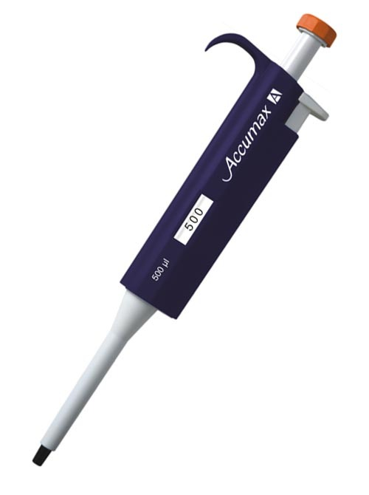
Error
Source: Human Error
Contamination: bacteria from outside experiment
Misuse of pipette
Fail to heat shock – opens pours in bacteria to access DNA

Slide 16
Sterile Technique
Keep plates closed as much as possible
Label of sides of plates
Change pipette tips
Wash hands before and after
Sterilize surfaces (Lysol solution)

Slide 17
Day 1: Plate Bacteria
Take Plate
Label the side with team name and class period
Take a sterile loop
Collect bacteria from your body
Plate bacteria
Don’t dig into agar
Its like jello
Tape closed
Flip upside down
Incubate
SAFTEY: E. COLI IS DANGEROUS (THIS IS A WEAK STRAIN) WASH YOUR HANDS!
Starter Plate
Yours
E.Coli

Slide 18
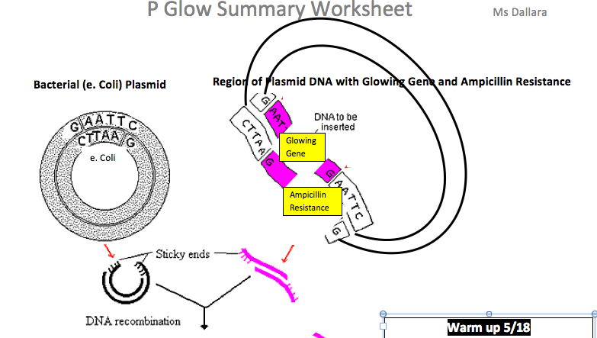
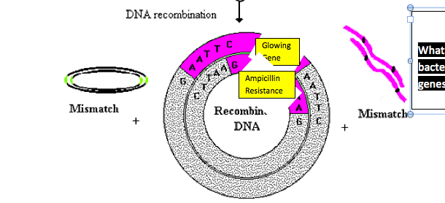
WARM UP 5/18
ANSWER QUESTION ON HANDOUT
Warm up 5/18
What are the Characteristics of the bacteria now? (Hint each of the 2 genes affect the bacteria)

Slide 19
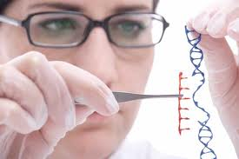
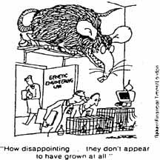
5/18
Warm Up on handout
Check Annotated Reading (#43)
Demo of P-Red
P-Red Day 2 protocol
Purpose: Day 2 of the P-Red lab, Be real scientists and integrate genes from one organism into another! – see results Monday (hopefully)

Slide 20
Day 2: Transfer Bacteria
USE HANDOUT FOR PROCEEDURE:
Take starter Plate and get 4 new plate
Label ependorf tubes +DNA or -DNA
Take a sterile loop and collect one colony from E. Coli Side and mix in each ependorf tube
Get P.Glow DNA from in +DNA Tube
Plate bacteria: Don’t dig into agar - Its like jello
Tape closed
Flip upside down
Incubate
SAFTEY: E. COLI IS DANGEROUS (THIS IS A WEAK STRAIN) WASH YOUR HANDS!
Yours
E.Coli
LB - Control | LB/Amp | LB/Amp/+DNA | LB/Amp/ARA/+DNA
+ DNA
- DNA

Slide 21
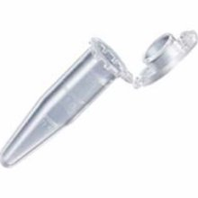
Each Group Needs
4 plates
2 epindorf tubes Label: 1) + DNA 2) - DNA
Sharpie
1 Styrofoam raft (Label it on tape)
1 transfer pipette
2 sterile loops
Collect colonies from e. Coli Plates
1 glob = 1 colony, grew from a single bacteria!
LB - Control | LB/Amp | LB/Amp/+DNA | LB/Amp/ARA/+DNA

Slide 22
Plates and Function
LB: Broth = Food
AMP: Ampacillin – kill bacteria
Our E.Coli is Ampacillin resistant
ARA: Arabinose = Sugar that initiates transcription
Allows jelly fish DNA to combine with Bacterial DNA

Slide 23
Day 3: Examine
4 plates
LB - Control
LB/Amp
LB/Amp/+DNA
LB/Amp/ARA/+DNA
Write hypothesis (worksheet) – filled out sheet is ticket to get black light/goggles and dishes
Examine samples with Black light
Record observations
Yours
E.Coli
+ DNA
- DNA

