Slide 1
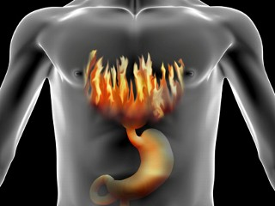
What is a phenomenon: heartburn
Phenomenon: a fact or situation that is observed to exist or happen, esp. one whose cause or explanation is in question.

Slide 2
Heartburn
Heartburn isn't fun. Heart burn is caused by stomach acid coming up and burning you esophagus. That’s were the term heart burn comes from. Your heart isn't being burned but it sure feels like it.

Slide 3
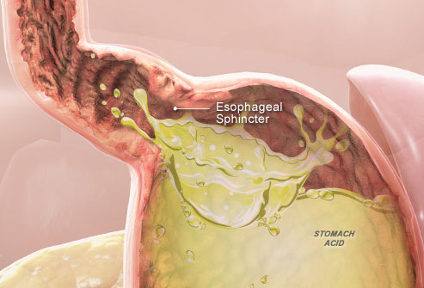
What causes heartburn and it what order?
Heartburn is caused by excess stomach acid. Excess stomach acid can be caused by lots
things the main one being diet, spicy or oily food in particular but stomach acid has also
been know to be cause by lack of sleep.
excess stomach acid
burns the lower esophageal sphincter and damages it to the point were it doesn’t function well.
Acid comes up and burns the esophagus
Damaged sphincter

Slide 4
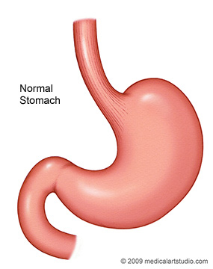
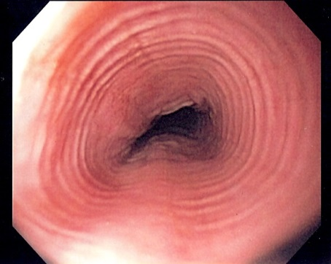
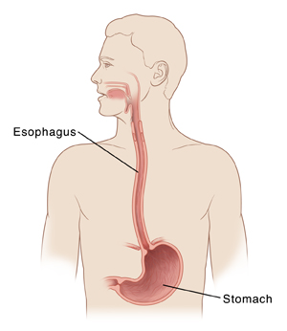
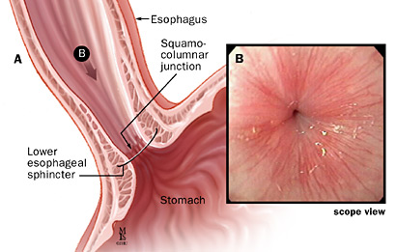
What natomical structures are involved in heartburn?
Stomach
acid
lower esophageal sphincter
esophagus

Slide 5
How to fix it.
Drinking lots of water(it helps by keeping the acid down in)
Chewing gum(it helps stimulate the saliva gland which helps wash down the acid)
Tums(tums and other medicines like it are Antacids which tone down the power of your stomach acid)
Most remedies cant completely get rid of it because it is almost impossible to fix the lower esophageal sphincter. In the end to best way to avoid heartburn is to not eat the food that can cause it.

Slide 6
Bibliography
"5 Home Remedies for Heartburn."Home Remedies for Acid Reflux. N.p., n.d. Web. 20 Mar. 2014. <http://www.health.com/health/gallery/0,,205277
"Email a link." Antacids. N.p., n.d. Web. 19 Mar. 2014. <http://www.heartburn.com/reliefandm
"Heart burn alternative fixes?." Yahoo! Answers. Yahoo!, n.d. Web. 20 Mar. 2014. <http://answers.yahoo.com/question/index?qid=20110531183202AAWfscv>.
WebMD. WebMD, n.d. Web. 20 Mar. 2014. <http://www.webmd.com/heartburn-gerd/ss/slideshow-heartburn-overview>.
"How to Relieve Heartburn." wikiHow. N.p., n.d. Web. 20 Mar. 2014. <http://www.wikihow.com/Relieve-Heartburn>.
"Natural Remedies for Heartburn."Wake Up World. N.p., n.d. Web. 20 Mar. 2014. <http://wakeup-world.com/2012/04/14/natural-remedies-for-heartburn/>.
"Heartburn: MedlinePlus Medical Encyclopedia." U.S National Library of Medicine. U.S. National Library of Medicine, n.d. Web. 20 Mar. 2014. <http://www.nlm.nih.gov/medlineplus/ency/article/003114.htm>.

