Slide 1
Pheromones and Scraps of Behavior (FAP, Mating Systems, Imprinting and Aggression)

Slide 2
Various behaviors controlled by hormones, neurohormones and/or biogenic amines in insects and the various chemicals used by the insect
Mating
Migration and dispersal
Host finding behavior
Reproductive behavior
Social behavior
Rhythms and behavior
Pheromones and behavior
Adaptive behavior
Source:

Slide 3
Scientific Uses of Pheromones
One way of using sex pheromones for insect control is by mass trapping.
A lot of traps are set out to catch most of the males before they can fertilize the females.
Unfertilized females will only lay sterile eggs that won't hatch.
Another method is the confusion technique.
A general area is sprayed with the pheromone to confuse the males that are trying to find a mate.
Both these methods are expensive and therefore not usually practical.
3. However, just a few traps are enough to tell when the mating season of the insect occurs. With that information insecticide sprays can be timed for maximum effectiveness.

Slide 4
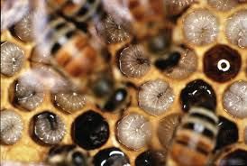
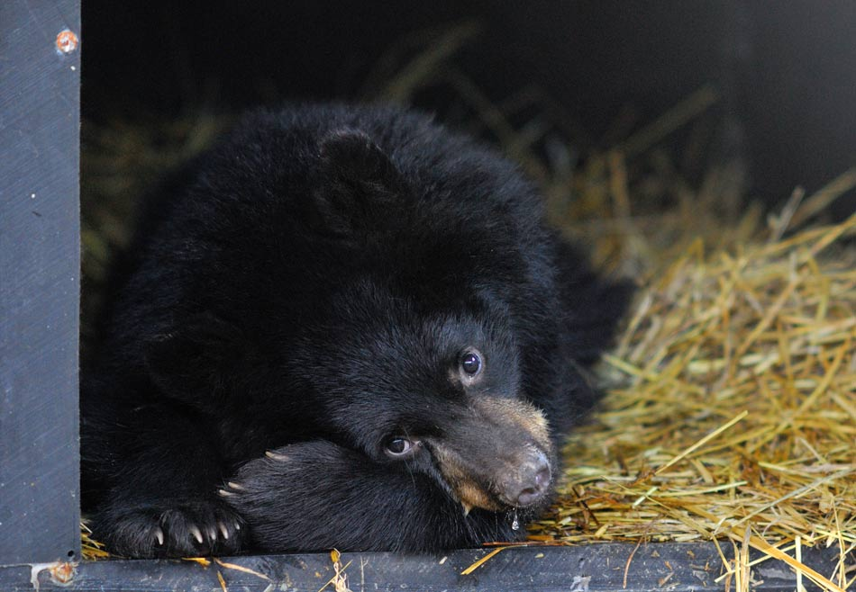
Pheromones and Fixed Action Patterns
Fixed Action Patterns (FAP): Stereotypical behaviors that occur in predictable and inflexible sequence in response to something happening in the environment.
General Ex: When winter comes (releaser) the bear hibernates.
Pheromone Ex: Certain smell from queen bee means take care of babies

Slide 5
Mating Systems
Mating Systems
Monogamous - one male and female
Way in which a group is structured in relation to sexual behavior

Slide 6
Mating Systems
Polygamy - more than one mate
Polygyny (one male)
Resource defense
Female defense
Male-dominance

Slide 7
Mating Systems
Polygamy - more than one mate
Polyandry (one female)
Ex: Monkey (the marmoset):
In a group the dominant female suppresses ovulation in non dominant females (How: pheromones)

Slide 8
Mating Systems
Leks -
Bower bird
a display ground where males attract females
ex) male sage grouse

Slide 9
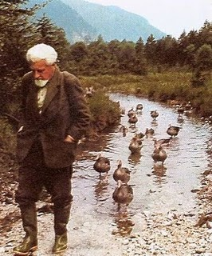
Imprinting
Occasionally it happens as an adult
The imposition of a stable behavior in a young animal to by exposure to particular stimuli during a critical period in the animals development
Example: Geese/Ducks imprint on first animal they see
VIDEO: Imprinting Experiment with Konrad Lorenz

Slide 10
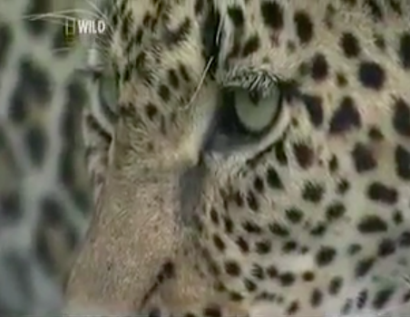
Aggression and Dominance
Social relationships require cooperation
When ritualized behaviors fail:
FIGHT TO THE DEATH/INJURY
Competition for food, water, mates, shelter… wrecks cooperation
Aggression helps resolve competition
Most lacks violence
Often ritualized displays to avoid violence

