Slide 1
Unit #2: Animal Behavior
Unit Overview Project

Slide 2
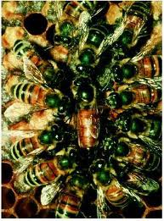
Goal
Make a presentation on your section
Use: Google Presentation (link for your class on assignment sheet)
One document for the whole class so it’s a cohesive presentation
Create a Key Term List
Include in your presentation
Guideline:
Probably a slide for each bold heading
Do a little research outside of the textbook reading
You will present
Include:
Visuals (pics/videos)
Notes
Summary/big idea of your section

Slide 3
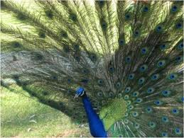
Chapter 36 – Sections
Intro 753-754
Describing Behavior 754-755
Control behavior 755-758
Social Behavior 759-768
Intro-Territoriality 759-763
Mating Systems – altruistic behavior 763-765
Animal Communication 765-768
Summary 769

