Slide 1
Homeostasis
"Homeostasis" - ability to maintain relatively stable internal conditions

Slide 2
This Week Chapter 30/Homeostasis
Goal:
HW
Understand the role of homeostasis in the body.
Due: Tuesday
Thermoregulation Reading:
Pages: 646-652
Outline: Main Ideas
Key Terms: define

Slide 3
Term ‘Homeostasis’
What: The term ‘homeostasis’ is derived from two Greek words;
Homeo which means ‘unchanging’
Stasis which means ‘standing’
Why: "Homeostasis" ______________________________________________________________________________________________________
How: Feedback loops

Slide 4
What does the word “feedback” mean? With what do you associate this term?
Brainstorm:

Slide 5
Feedback Loop
Example: Progress Report Cards and Grades
Why: for students to gauge their performance in there classes.

Slide 6
What would you consider normal or acceptable range for your grades? What happens when you fall outside of (below) that range?
Brainstorm:
Notes:
Students should identify that

Slide 7
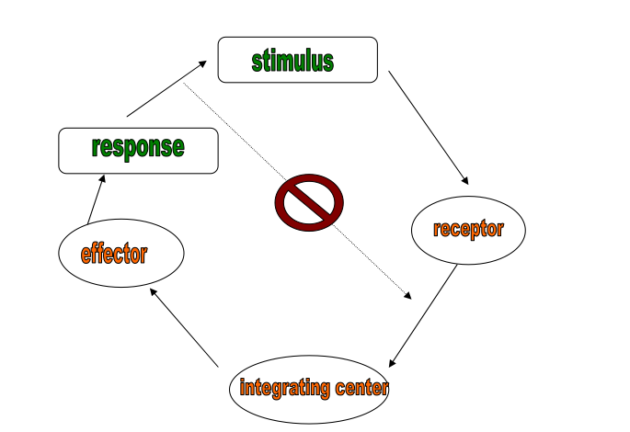
The human body works in the same way
=
=
=
=
=

Slide 8
“What things/processes in the human body need to be kept within a particular range?”

Slide 9
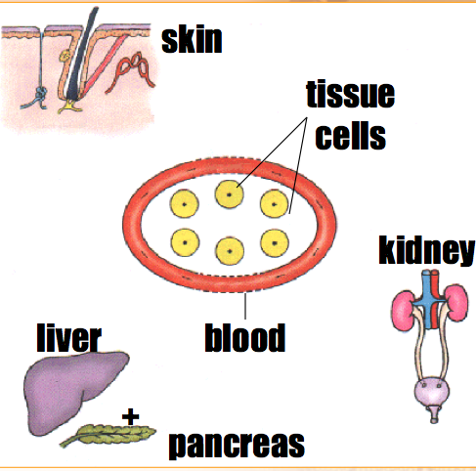
OVERVIEW: Parts of Body involved
____________:
regulate water & mineral salts concentration
____________:
regulate body temperature
_______ & _________:
regulate blood glucose level

Slide 10
Osmoregulation (Water & Mineral salts)
Regulate water potential in Tissue Fluid
Organ involved: _________

Slide 11
Osmoregulation - Feedback loop
After Sweating
Concentrated Blood
___________Urine is produced
________ Water Content in Blood
Larger proportion of water is reabsorbed

Slide 12
Osmoregulation - Feedback loop
After Drinking
Diluted Blood
__________Urine is produced
Normal Water Content in Blood
Smaller proportion of water is reabsorbed

Slide 13
Osmoregulation (Water & Mineral salts)
After having a very salty meal
produce ________urine to remove excess salts in solution form
extra _______is needed to be excreted along with the excess salts
sensation of thirst (drink more water to compensate for the water loss)

Slide 14
Thermoregulation (Body Temperature)
Regulate body temperature
Organ involved: ______

Slide 15
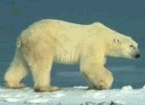
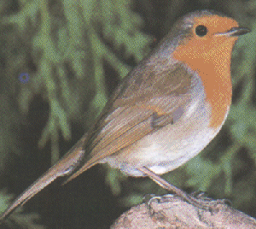
Thermoregulation (Regulation of Body Temperature)
_________AKA warm-blooded animals
keep body temperature constant even in winter by increasing metabolic rate
e.g. birds, mammals

Slide 16
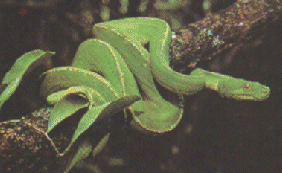
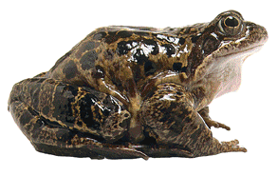
Thermoregulation (Regulation of Body Temperature)
________AKA cold-blooded animals
body temperatures vary with that of the environment
e.g. reptiles, fish, amphibians

Slide 17
Mechanisms for Thermoregulation
Insulation
Evaporative cooling
_________, panting, bathing
Shivering
Nonshivering thermogenesis & brown fat
Circulation adaptations
Countercurrent exchange
Vasodilatation (cooling)
Vasoconstriction (heat conservation)
Behavioral responses

Slide 18
Glucoregulation (Sugar)
Regulate body sugar
Organ involved: Liver & _______

Slide 19
Regulation of Blood Glucose Level
controlled by Negative __________ mechanism
controlled by insulin secreted from the pancreas

Slide 20
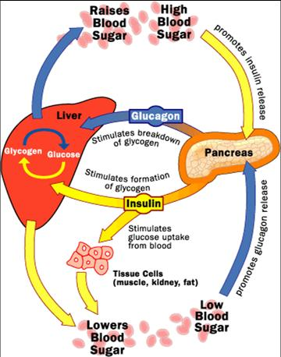
Diabetes
Malfunction of pancreas
Does not secrete enough insulin

Slide 21
Pancreas secretes insulin
Liver coverts glucose to glycogen
Too High
Blood glucose level falls
Soon after a meal
normal blood glucose level
normal blood glucose level
Long after a meal
Pancreas secretes less insulin
Liver converts glycogen to glucose
Too Low
Blood glucose level rises

