Slide 1
Ninja Species
Flex Project

Slide 2
Project
You get to be an expert on a species! Goal: Take a known Ninja Species, a species with crazy awesome adaptations, and evolve that. You can create any life history characteristics you want, you just need to justify them scientifically.
- BasicallydecorateyourSpeciesandmakeapresentationtoinclude:(pleasegoinorderof this sheet in your presentation)

Slide 3
Basic
Name the species:
- Common name
- Scientific name (Genus species)
What is its closest extant (living) relative?
- How do you know?
What is its closest extinct (non-living) relative? - This is where you include some research on the real species that you modified.

Slide 4
Habitat
Explain where you are likely to find them?
Why do they look the way they do?
Adaptations:
- Size, feet, scales/skin/feathers neck, tail,
- Sensory structures/features?
- Unique feature
Why do they look the way they do?
- Sexual selection (because the ladies like it)
- Camouflage

Slide 5
Life History
Social?
- Social or solitary?
- What is a group of them called?
Reproduction
- How do they signal to mates?
- Do they have any courtship rituals?
- Development? Direct, indirect...
Elaborate
- Maternal instinct? Maternal/paternal
care:
Diet
- Eating habits
- Tooth morphology
- Predator or prey?
- Greatest threats to species?
Sounds:
- When does it vocalize?

Slide 6
Introducing your Species
Close Relative!

Slide 7
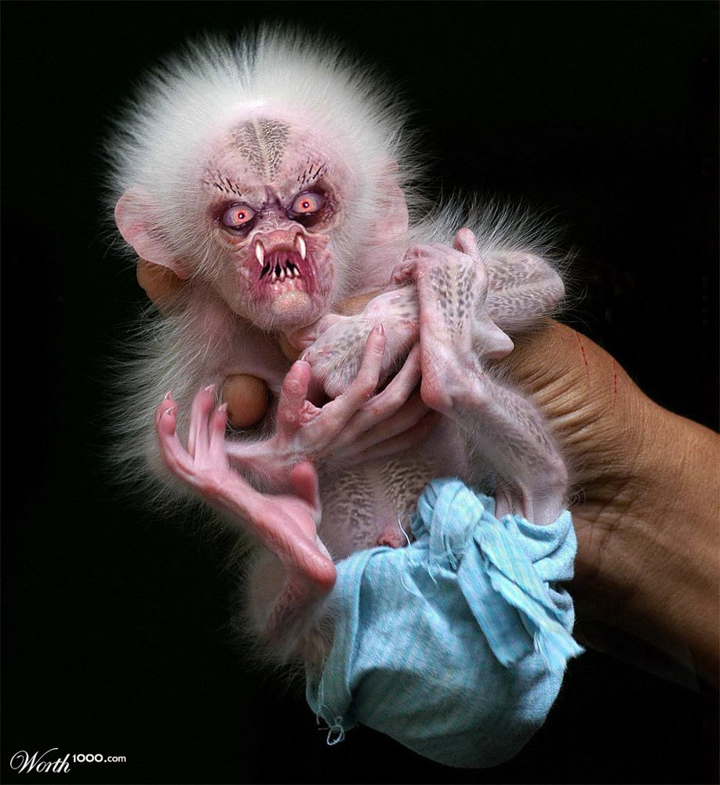
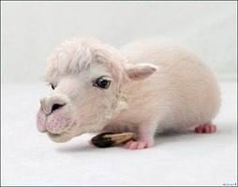
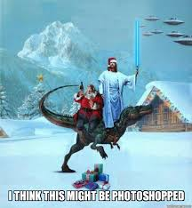
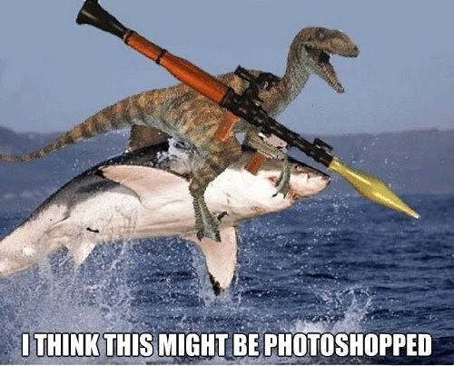
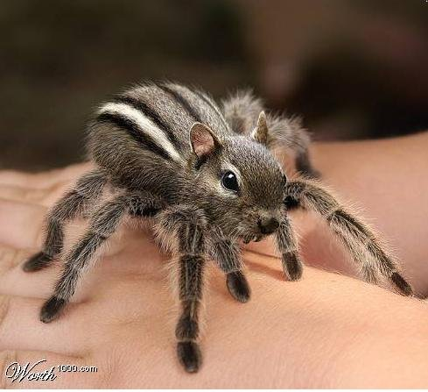
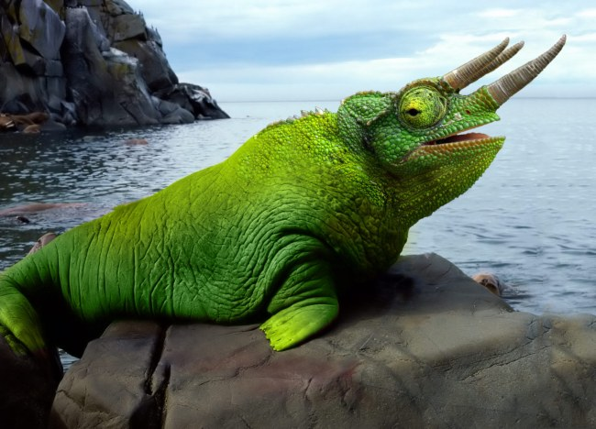
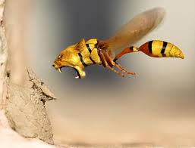
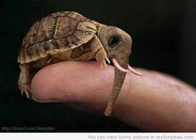
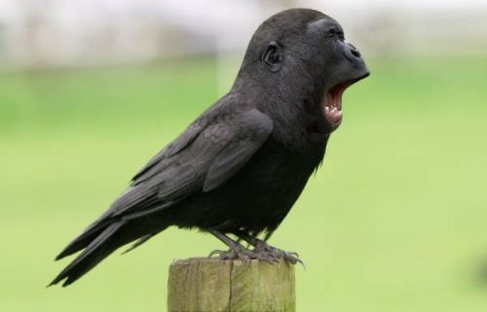
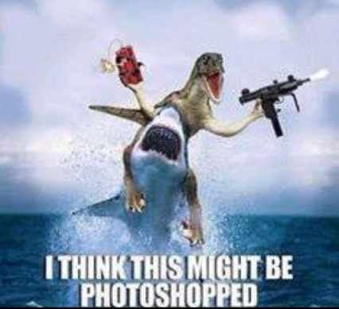
I will not stifle your creativity

Slide 8
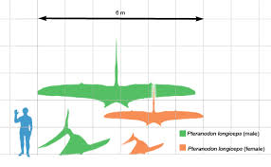
Zach and Erik
Pteranodon “Toothless, Wing”
Some of the largest known flying reptiles, with wingspans over 6 metres (20 ft). – Longer than any known bird.

Slide 9
The Crest
Use
Sexual Dimorphism
Debated, likely for Mating Display
Males: Larger
Females: Triangular
Wiki
http://www.enchantedlearning.com/subjects/dinosaurs/facts/Pteranodon/

Slide 11
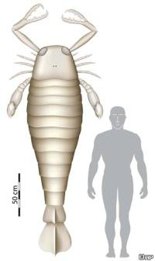
Tess and Sopah
http://drprem.com/green/fossil-of-giant-scorpion-found
Giant Sea Scorpion!
Recently, British scientists stumbled across a fossilized claw –
part of an ancient sea scorpion. Given the large size of the claw, scientists have estimated that the scorpion was 8 feet long.

Slide 12
Giant Sea Scorpion

Slide 13
Create in Fab Lab

