Slide 1
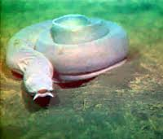
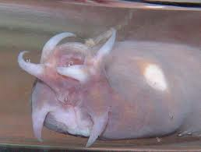
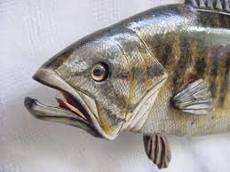
Ancestral Vs Derived
Ancestral:
Trait of the ancestor
“Older model”
Often less complex
Derived:
Trait that is present in the organism, but not in the common ancestor (of the group being considered).
“New and Improved Model”
Not always more complex, but usually
(Ex: tape worms lost their digestive track)
No Jaws
Jaws

Slide 2
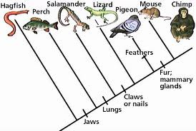
Cladistics
What:
Used to determine relative timing of divergences.
Why? Because it tells us about who evolved when
The hierarchy, or ranking, of groups derives logically from their genealogical position.
Example:

Slide 3
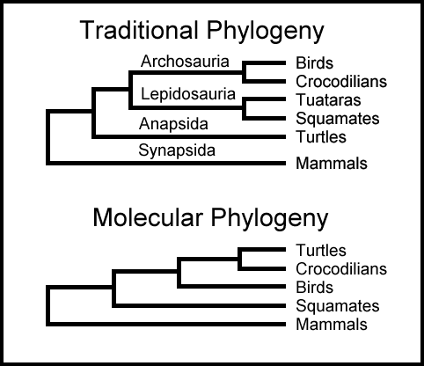
Cladistics
Tools: (WHAT DO YOU USE TO BUILD ONE?)
Characters/Morphology
Embryology
Genetics (molecular tools)
Example:

Slide 4
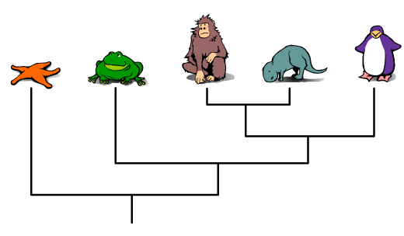
How to Build a Cladogram
http://ccl.northwestern.edu/simevolution/obonu/cladograms/Open-This-File.swf
Cladogram by Brightstorm: http://www.youtube.com/watch?v=3DxNwzzjm_4

