Slide 1
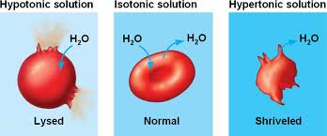
Osmosis Notes

Slide 2
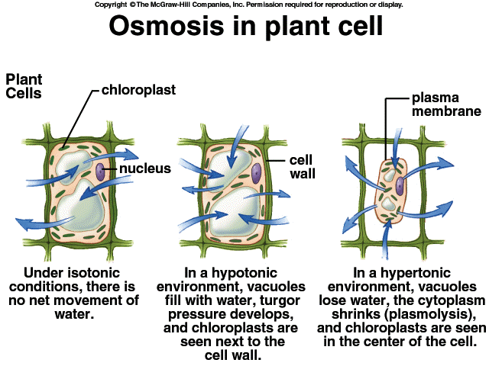
Key Terms - Osmosis
OSMOSIS: Passive (not energy needed) diffusion of water through a.
Semipermeable membrane: Who has one of these? A cell!
A simple rule to remember is: SALT SUCKS!
Salt is a solute, when it is concentrated inside or outside the cell, it will draw the water in its direction.
This is also why you get thirsty after eating something salty.

Slide 3
Key Terms - Transport
Transport
Diffusion and Osmosis are both types of PASSIVE TRANSPORT - that is, no energy is required for the molecules to move into or out of the cell.
Sometimes, large molecules cannot cross the plasma membrane, and are "helped" across by carrier proteins - this process is called facilitated diffusion.
This process, if carried out against the concentration gradient, is called ACTIVE TRANSPORT, requires energy.

Slide 4
Key Terms - Solutions
Type of Solutions: Overview
Solution
ISOTONIC "ISO" means the same | If the concentration of solute (salt) is equal on both sides -No net movement of water
HYPOTONIC "HYPO" means less | In this case there are less solute (salt) molecules outside the cell -The cell will gain water and grow larger
HYPERTONIC "HYPER" means more | The word, in this case there are more solute (salt) molecules outside the cell -The cell will lose water and shrink

Slide 5
ISOTONIC
"ISO" means the same
Same solution on both sides
Equal movement in and out
If the concentration of solute (salt) is equal on both sides, the water will move back in forth but it won't have any result on the overall amount of water on either side.

Slide 6
HYPOTONIC
"HYPO" means less
“Hypo = Hippo (big fat guy)”
Less solute (salt) molecules outside the cell, since salt sucks, water will move into the cell.
The cell will gain water and grow larger.

Slide 7
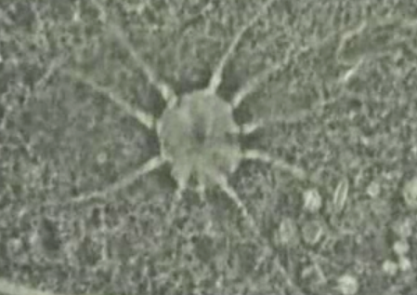
HYPOTONIC Strategies
How to deal with swelling up and not pop!
Contractile Vacuole
ANIMAL CELL:
The cell may be in danger of bursting, organelles called CONTRACTILE VACUOLES will pump water out of the cell to prevent this
PLANT CELL:
The central vacuoles will fill and the plant becomes stiff, the cell wall keeps the plant from bursting

Slide 8
HYPERTONIC
"HYPER" means more
“Hyper, hyper people burn lots of energy and are skinny!”
The word, in this case there are more solute (salt) molecules outside the cell, which causes the water to be sucked in that direction.
PLANT CELLS: the central vacuole loses water and the cells shrink, causing wilting.
ANIMAL CELLS: the cells also shrink.
In both cases, the cell may die.

Slide 9
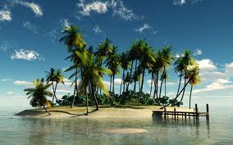
The Problem with HYPERTONICa
DANGER!
This is why it is dangerous to drink sea water, people marooned at sea will speed up dehydration (and death) by drinking sea water.
This is also why "salting fields" was a common tactic during war, it would kill the crops in the field, thus causing food shortages.
Its a myth that drinking sea water will cause you to go insane

Slide 10
Summary
(From your flexbook)
All cells are very small because they need to pass substances across their surface. Their small size gives them a relatively large ratio of surface area to volume, facilitating the transfer of substances.
The shapes of cells may vary, and a cell’s shape generally suits its function.

Slide 11
Helpful Sites
Cell Membrane Structure:
http://www.wisc-online.com/objects/index_tj.asp?objID=AP1101
http://www.youtube.com/watch?v=moPJkCbKjBs
http://www.youtube.com/watch?v=Rl5EmUQdkuI&feature=related
Diffusion and Osmosis:
http://www.biologycorner.com/bio1/diffusion.html
http://www.phschool.com/science/biology_place/labbench/lab1/intro.html
http://www.youtube.com/watch?v=VUnvwrx8Wq4

