Slide 1
Phylogenetic Trees
A diagram to show relationships between organisms.

Slide 2
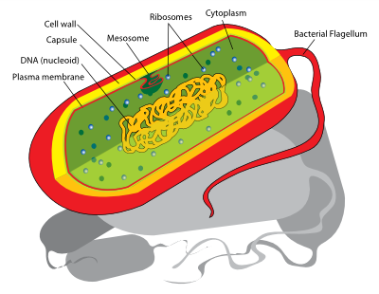
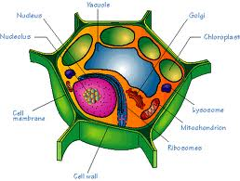
Ancestral Vs Derived
Ancestral:
Trait of the ancestor
“Older model”
Often less complex
Like the prokaryotes
Derived:
Trait that is present in the organism, but not in the common ancestor (of the group being considered).
“New and Improved Model”
Not always more complex, but usually
Like Eukaryotes

Slide 3
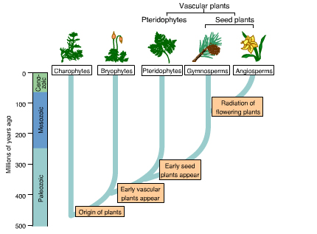
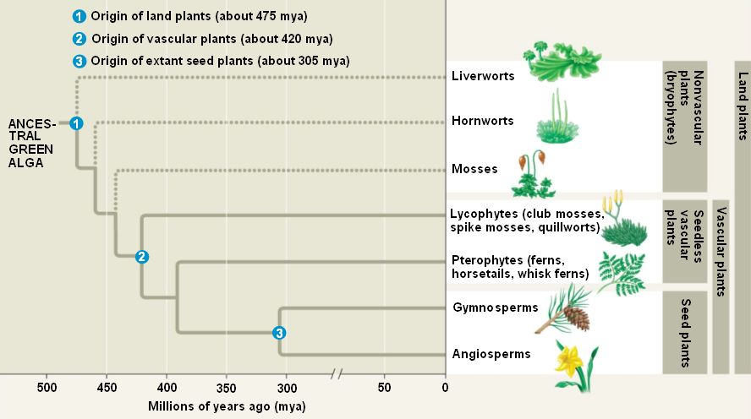
Cladistics
What:
Used to determine relative timing of divergences.
Why? Because it tells us about who evolved when
The hierarchy, or ranking, of groups derives logically from their genealogical position.
Example:

Slide 5
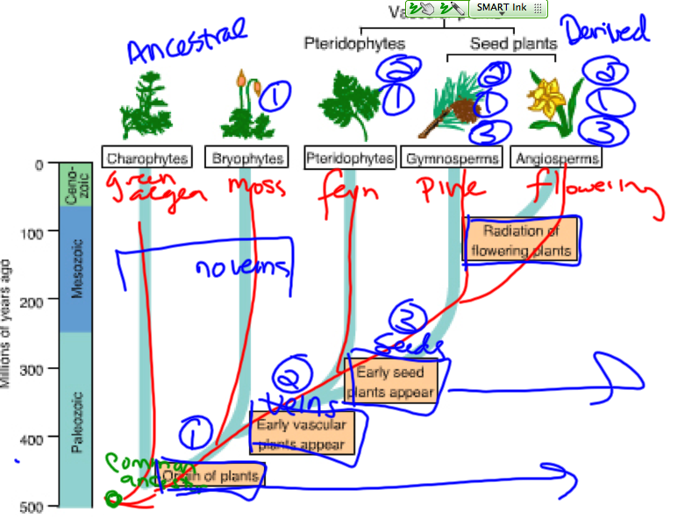

Slide 6
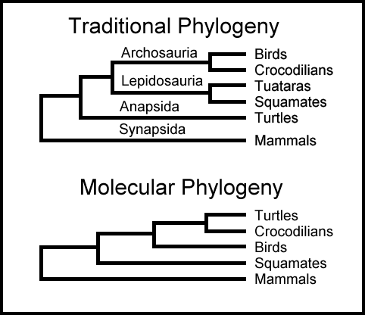
Cladistics
Tools: (WHAT DO YOU USE TO BUILD ONE?)
Characters/Morphology
Embryology
Genetics (molecular tools)
Example:

Slide 7
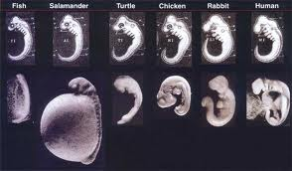
Embryology

Slide 8
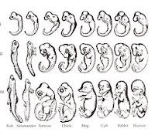
Embryology

Slide 9
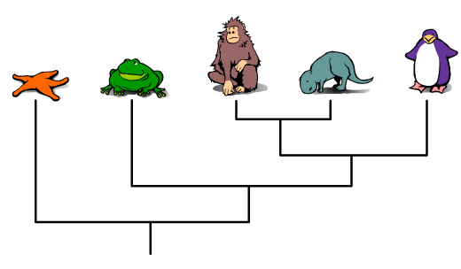
How to Build a Cladogram
http://ccl.northwestern.edu/simevolution/obonu/cladograms/Open-This-File.swf
Cladogram by Brightstorm: http://www.youtube.com/watch?v=3DxNwzzjm_4
Eyes
Eyes
Eyes
Eyes
Eyes

Slide 10
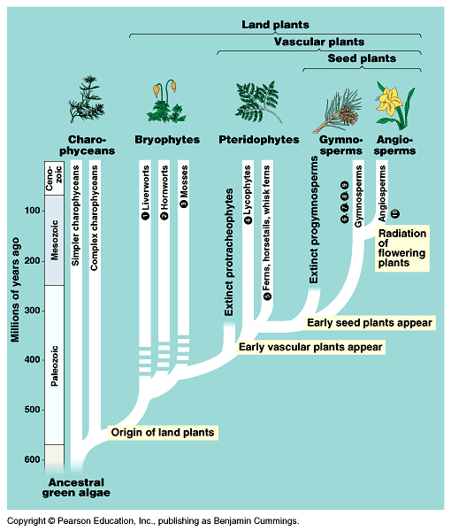

Slide 11
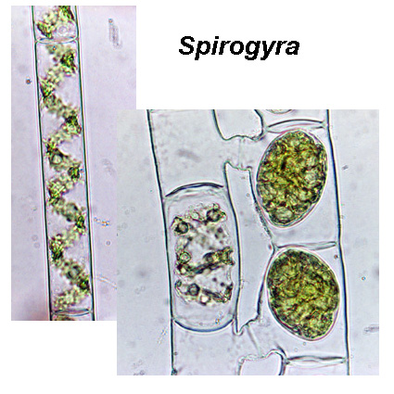
Charophytes
Green Algae
Spirogyra, stonewoand desmids are all members of this fresh-water group of "green algae".
The base of the plant family

