Slide 1
Ectopic Pregnancy

Slide 2
What is it?
Embryo develops in abnormal location other than the uterus.
Most ectopic pregnancies occur in the Fallopian tubes. Some occur in the ovaries, stomach area or cervix.
Occur in 1 in very 100 pregnancies.
If not detected, internal bleeding will occur and can lead to death

Slide 3
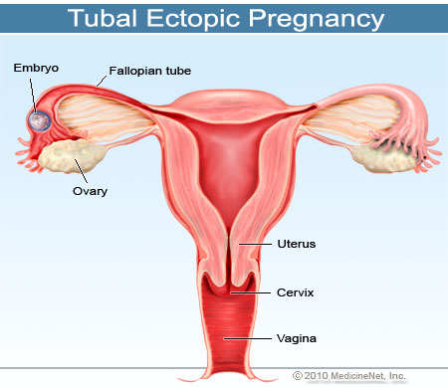

Slide 4
Types of Ectopic Pregnancies
Tubal Ectopic pregnancy
Ovarian pregnancy
Intra-abdominal Pregnancy
Cervical pregnancy
Heterotopic pregnancy

Slide 5
Causes
Over the age of 35
Having many sexual partners
In vitro fertilization
Scaring from past infections or surgery, c section, open laparotomy
Endometriosis

Slide 6
Treatments/Prevention
Drug therapy
Methotrexate
Laparoscopic surgery of the fallopian tubes or any other area effected (cervix, ovaries, ect.)

Slide 7
Fallopian Tube Surgery Video
This demonstrates the laparoscopic surgical treatment of a tubal ectopic pregnancy. May be disturbing to some people.
https://www.youtube.com/watch?v=dpRrHBB-iow

