Slide 1
Writing Your Lab Conclusion
* Rate of Photosynthesis Lab

Slide 2
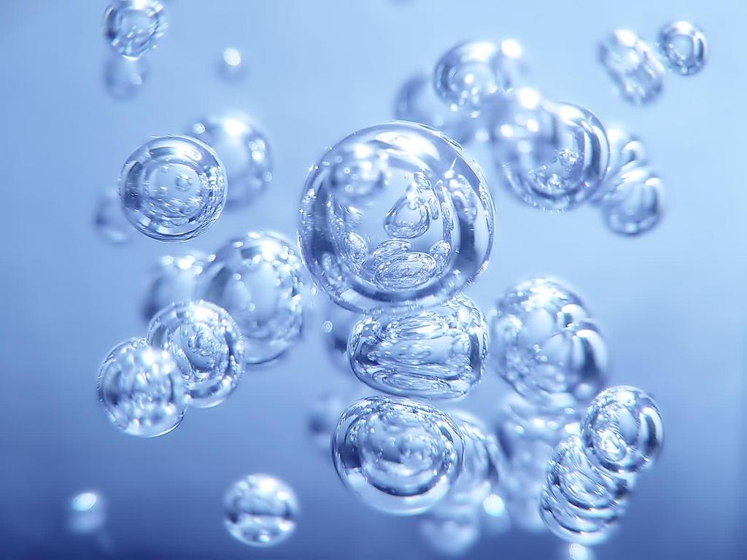
Conclusion of a Lab
A standard format is detailed below:
First, write a topic sentence (or sentences), which reminds the reader of the purpose for the experiment (stating the effect of the independent variable on the dependent variable).
Second, describe the data and its reliability with references to actual data tables and graphs. Do this by stating and comparing the calculated values for central tendency and variation (using the appropriate descriptive statistics) between IV levels.
Third, offer reasons/explanations for patterns that are observed in the data. An experiment may produce results that meet the expectations (support the hypothesis) or it may produce results that do not meet the expectation (do no support the hypothesis). Provide explanations and speculations for both types of results – expected and unexpected. Carefully examine the experimental design, considering the effects of all constants, controls and variables. Include a critique of the experimental procedures, that is, the manner in which the experimental design was actually implemented.
Finally, describe how the data supports or refutes the hypothesis. Compare the findings with other researchers and the “real world”. Offer recommendations both for improving the experiment and for further study.

Slide 3
Conclusion of a Lab
A standard format is detailed below:
First, write a topic sentence (or sentences), which reminds the reader of the purpose for the experiment (stating the effect of the independent variable on the dependent variable).
Paragraph #1: What background info./prior knowledge supports the experiment?
Photosynthesis
purpose
reactants and products
light and dark reaction
*Use and cite Integrated Science 3-4 textbook as resource. See online Lab Report Format Information and resources:
http://zanniedallara.weebly.com/lab-report-format.html

Slide 4
Conclusion of a Lab
A standard format is detailed below:
Second, describe the data and its reliability with references to actual data tables and graphs. Do this by stating and comparing the calculated values for central tendency and variation (using the appropriate descriptive statistics) between IV levels.
Paragraph #2: What is the experiment design to test? Why is it important?
The effects of light intensity on photosynthetic rate
Rate of energy conversion and storage affects availability of food

Slide 5
Conclusion of a Lab
A standard format is detailed below:
Third, offer reasons/explanations for patterns that are observed in the data. An experiment may produce results that meet the expectations (support the hypothesis) or it may produce results that do not meet the expectation (do no support the hypothesis). Provide explanations and speculations for both types of results – expected and unexpected. Carefully examine the experimental design, considering the effects of all constants, controls and variables. Include a critique of the experimental procedures, that is, the manner in which the experimental design was actually implemented.
Paragraph #3: Why is the experiment being done?
Photosynthesis and Human Population
Energy is a limiting factor
Optimal amount of light for photosynthesis to support a growing population

Slide 6
Conclusion of a Lab
A standard format is detailed below:
Finally, describe how the data supports or refutes the hypothesis. Compare the findings with other researchers and the “real world”. Offer recommendations both for improving the experiment and for further study.
Paragraph #4: What are the predicted outcomes of the experiment? Explain
State predictions for each test
Explain why you expect each test to result as predicted

