Slide 1
Kidney Form and Function

Slide 2
Vertebrate Kidney Form
The kidneys receive blood through the renal artery and filters out waste from the blood.
The blood is passed through the structure of the kidneys called nephron, where waste products and excess water pass out of the blood stream, as shown in the diagram.

Slide 3
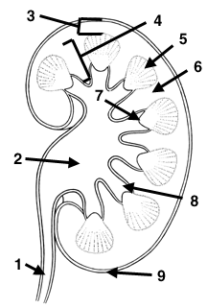
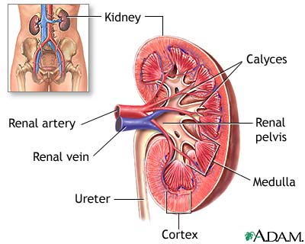
Renal Structure
1 = ureter
2 = pelvis
3 = cortex
4 = medulla

Slide 4
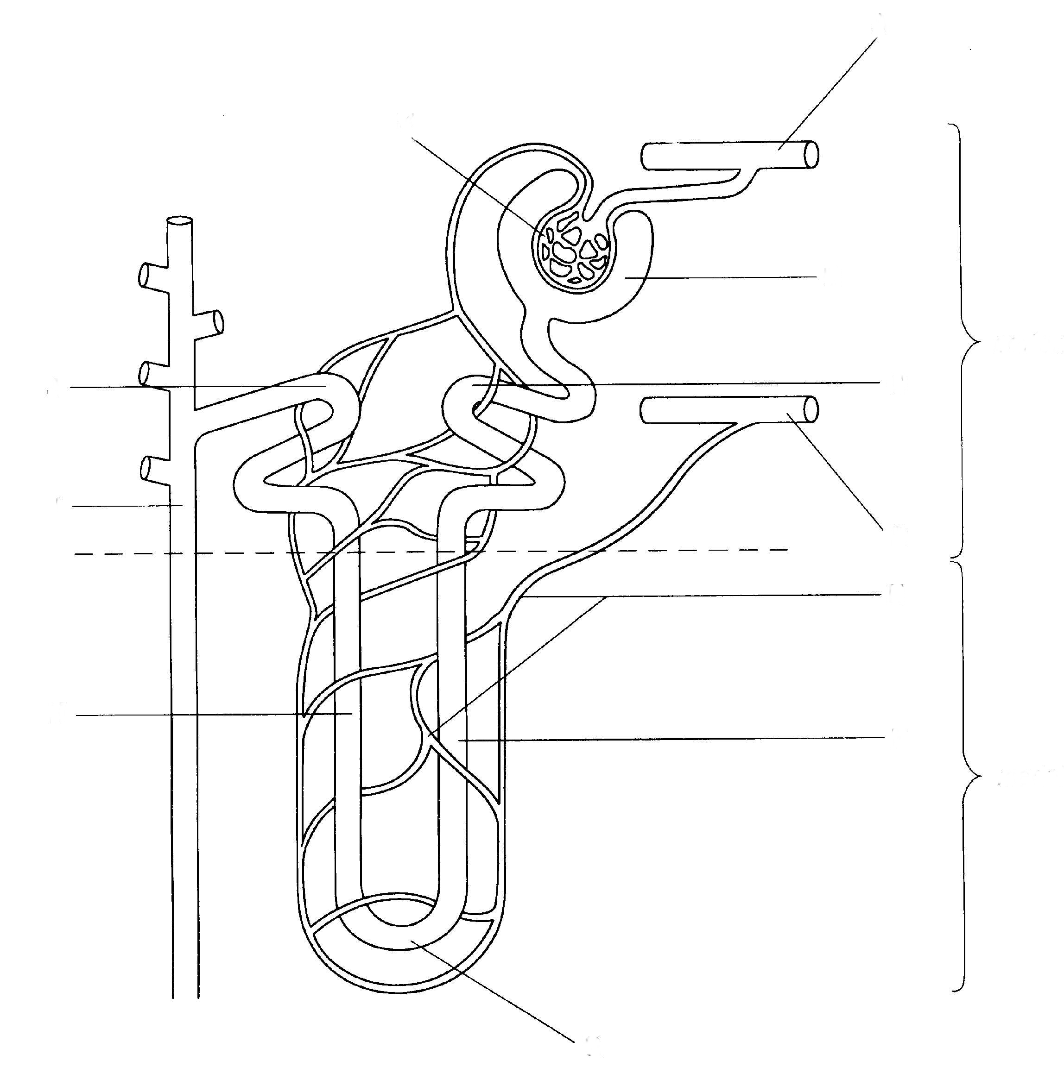
Kidney nephron – draw the flow
cortex
medulla
name the parts?

Slide 5
Kidney nephron – Name the parts
cortex
medulla
name the parts?

Slide 6
branch of renal artery
glomerulus
Bowman’s capsule
DCT
PCT
collecting duct
branch of renal vein
capillaries
Loop of Henle

Slide 7
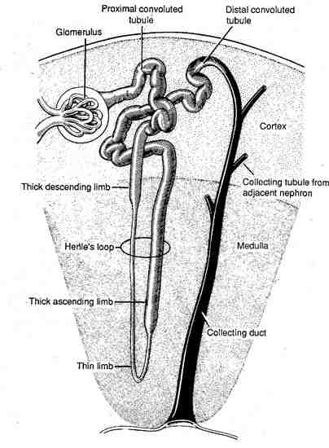
This WHOLE THING = The Nephron

Slide 8
Nephron
Functional unit of the kidney
Filtration, tubular reabsorption, tubular secretion
Renal corpuscle:
Glomerulus – capillaries
Glomerular or Bowman’s capsule

Slide 9
branch of renal artery
glomerulus
Bowman’s capsule
DCT
PCT
collecting duct
branch of renal vein
capillaries
Loop of Henle

Slide 10
Loop of Henle
Responsible for producing a concentrated urine by forming a concentration gradient within the medulla of kidney.
A higher concentration on the outside of the loop pulls out water for re-absorption.
The deeper the loop the more concentrated the pee will be.

Slide 11
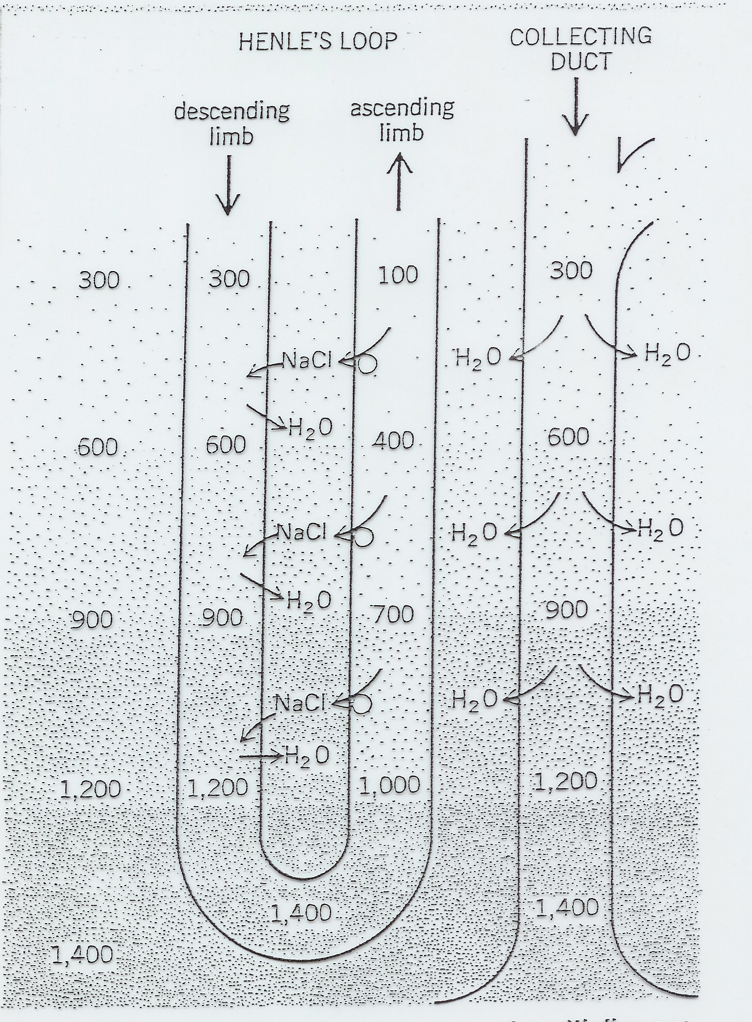

Slide 12
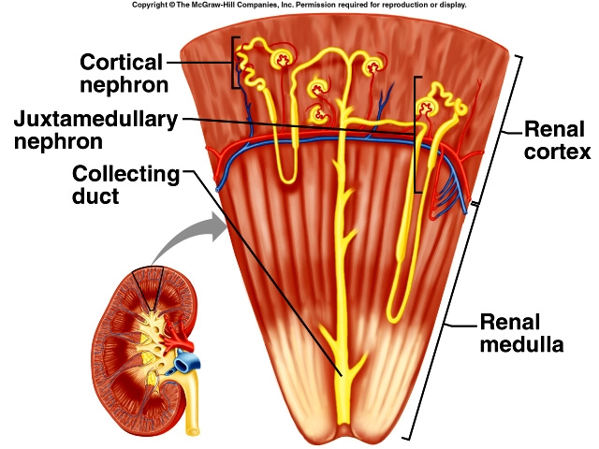

Slide 13
Why is it better to drink pee than not drink anything?

Slide 14
branch of renal artery
Glomerulus - around1.30min (2)
Bowman’s capsule
DCT
PCT
collecting duct
Loop of Henle
branch of renal vein
capillaries
Descending: Loop of Henle
Ascending: Loop of Henle

Slide 15
Bowman’s capsule
What: knot of capillaries inside the glomerular capsule
Fct: Receives filtrate
Nephron loop or Loop of Henle
Regulates concentration of urine
Collecting duct
Re-absorption of water and electrolytes
Re-absorption stimulate by Anti-Diuretics Hormone (ADH)
Capillaries & branch of renal artery:
Supply blood to be filtered
Descending | Ascending
Water leaves – OSMOSIS | Salt Leave – Active Transport (uses energy)

Slide 16
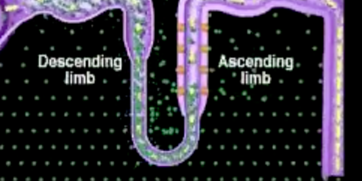
To Make Concentrated Urine
You need:
Long loop of henle:
With extreme concentrtion gradient to pull out ater and salt
ADH
Anti-diuretic hormone at collecting duct to make it soluble to water so more water can leave.

