Slide 1
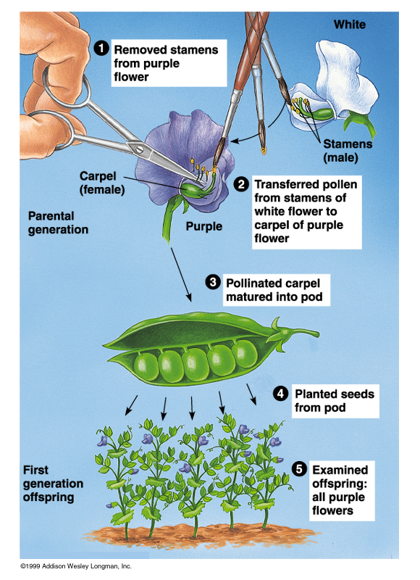
Mendelian Genetics II – Dihybrid Crosses
The
Process

Slide 2
Terminology to Learn
Trait
Heredity
Genetics
Punnett Square
Monohybrid Cross
Dihybrid Cross
Phenotype
Genotype
Genotypic ratio
Phenotypic ratio
Homozygous
Heterozygous
Dominant
Recessive
Allele
Law of Segregation
Law of independent assortment
Laws of Inheritance
Law of Dominance
Incomplete Dominance
Codominance
Sex-linked Traits
http://quizlet.com/10807965/genetics-flash-cards/

Slide 3
Law of Independent Assortment
Alleles for different traits are distributed to sex cells (& offspring) independently of one another.
This law can be illustrated using dihybrid crosses.

Slide 4
Dihybrid Cross
A breeding experiment that tracks the inheritance of two traits.
Mendel’s “Law of Independent Assortment”
a. Each pair of alleles segregates independently during gamete formation

Slide 5
Dihybrid Cross
Traits: Seed shape & Seed color
Alleles: R round r wrinkled Y yellow y green
RrYy x RrYy
RY Ry rY ry
RY Ry rY ry
All possible gamete combinations

Slide 6
Foil Method

Slide 7
Dihybrid Cross
Traits: Seed shape & Seed color
Alleles: R round r wrinkled Y yellow y green
RrYy x RrYy
RY Ry rY ry
RY Ry rY ry
All possible gamete combinations

Slide 8
Dihybrid Cross
RY
Ry
rY
ry
RY
Ry
rY
ry

Slide 9
Dihybrid Cross
RY
Ry
rY
ry
RY
Round/Yellow: 9
Round/green: 3
wrinkled/Yellow: 3
wrinkled/green: 1
RRYY
RRYy
RrYY
RrYy
Ry
RRYy
RRyy
RrYy
Rryy
rY
RrYY
RrYy
rrYY
rrYy
ry
RrYy
Rryy
rrYy
rryy
9:3:3:1 phenotypic ratio

Slide 10
Dihybrid Cross
Round/Yellow: 9 Round/green: 3 wrinkled/Yellow: 3 wrinkled/green: 1
9:3:3:1

Slide 11
Warm Up 3/26
What did you learn from Fridays lab on monohybrid crosses?
What did the rabbits in class help you learn?

Slide 12
Summary of Mendel’s laws
LAW
PARENT CROSS
OFFSPRING
DOMINANCE
TT x tt tall x short
100% Tt tall
SEGREGATION
Tt x Tt tall x tall
75% tall 25% short
INDEPENDENT ASSORTMENT
RrGg x RrGg round & green x round & green
9/16 round seeds & green pods 3/16 round seeds & yellow pods 3/16 wrinkled seeds & green pods 1/16 wrinkled seeds & yellow pods

Slide 13
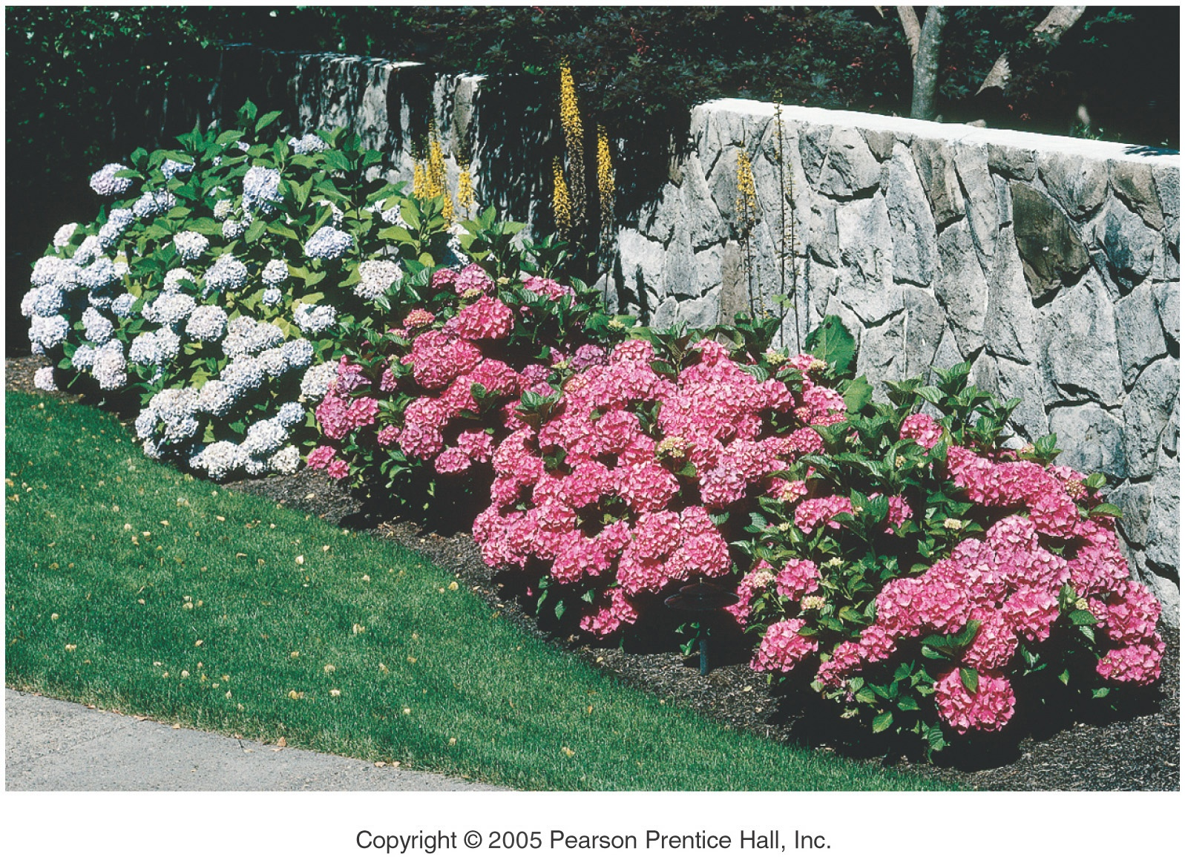
Genes and Environment Determine Characteristics

Slide 14
Environmental Impact on Phenotype
Phenotype = Genotype + Environment
Crop Yield = Genotype
+ Minerals
+ Water
+ Light
- Pests
etc.
Optimizing these factors determines agricultural productivity…last unit!
Human Skin Color = Genotype
+ Sun (UV) Exposure
- Aging Factors
The sun exposure effect is most obvious in people of intermediate skin base color
but everyone can have “tan lines.”

Slide 15
Environmental Impact on Phenotype
pH of the soil will change the color of hydrangea flowers from blue to pink

Slide 16
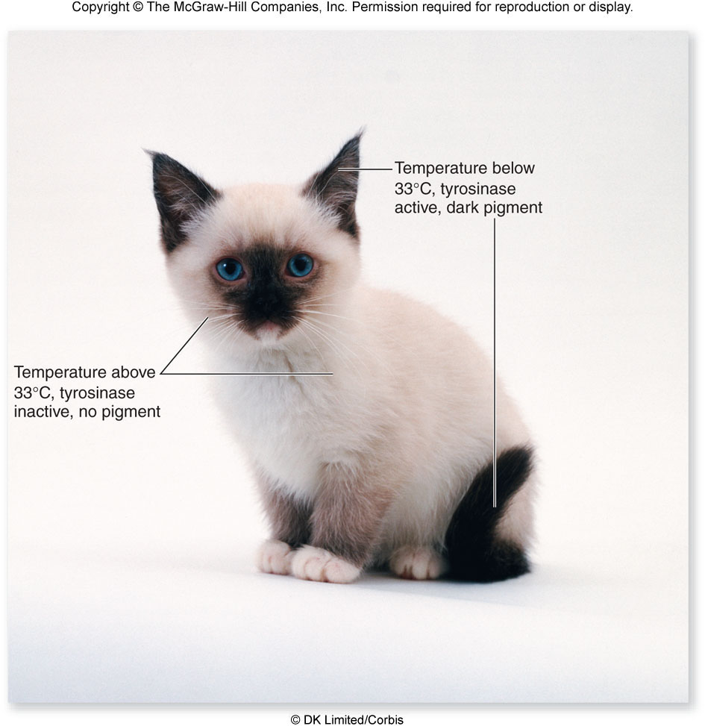
Environmental Impact on Phenotype

Slide 17
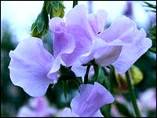
Mendel’s Pea Plant Experiments

Slide 18
Generation “Gap”
Parental P₁ Generation = the parental generation in a breeding experiment.
F₁ generation = the first-generation offspring in a breeding experiment. (1st filial generation)
From breeding individuals from the P₁ generation
F₂ generation = the second-generation offspring in a breeding experiment. (2nd filial generation)
From breeding individuals from the F₁ generation

Slide 19
Mendel’s Laws

Slide 20
Laws of Inheretance
Law of Segregation: When gametes (sperm egg etc…) are formed each gamete will receive one allele or the other.
Law of independent assortment: Two or more alleles will separate independently of each other when gametes are formed

Slide 21
Results of Monohybrid Crosses
Inheritable factors or genes are responsible for all heritable characteristics
Phenotype is based on Genotype
Which of these does natural selection act on?
Each trait is based on two genes, one from the mother and the other from the father
True-breeding individuals are homozygous ( both alleles) are the same

Slide 22
Law of Dominance
In a cross of parents that are pure for contrasting traits, only one form of the trait will appear in the next generation.
All the offspring will be heterozygous and express only the dominant trait.
RR x rr yields all Rr (round seeds)

Slide 23
Law of Dominance

Slide 24
Law of Segregation
During the formation of gametes (eggs or sperm), the two alleles responsible for a trait separate from each other.
Alleles for a trait are then "recombined" at fertilization, producing the genotype for the traits of the offspring.

Slide 25
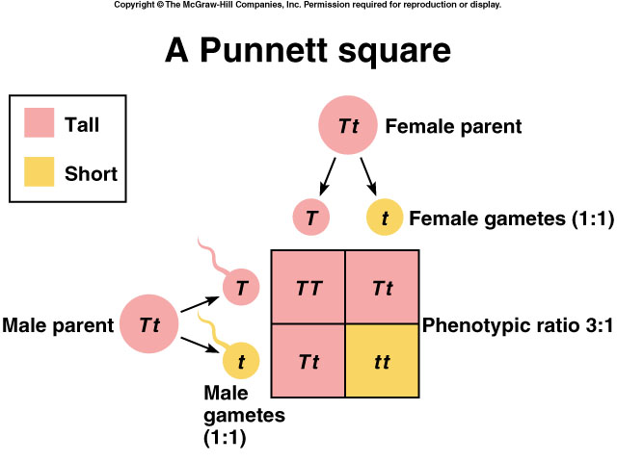
Applying the Law of Segregation

Slide 26
Law of Independent Assortment
Alleles for different traits are distributed to sex cells (& offspring) independently of one another.
This law can be illustrated using dihybrid crosses.

