Slide 1
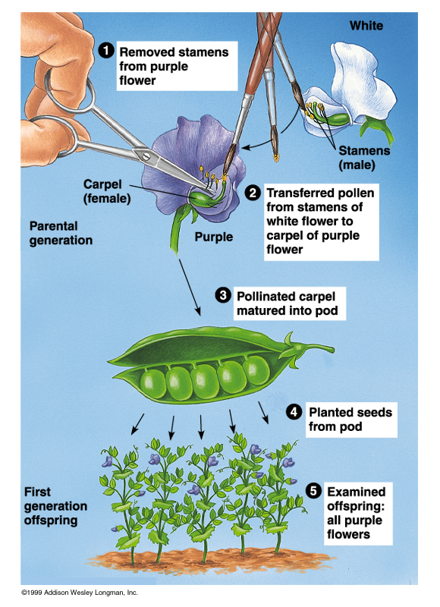
Mendelian Genetics
The
Process

Slide 2
Terminology to Learn
Trait
Heredity
Genetics
Punnett Square
Monohybrid Cross
Dihybrid Cross
Phenotype
Genotype
Genotypic ratio
Phenotypic ratio
Homozygous
Heterozygous
Dominant
Recessive
Allele
Law of Segregation
Law of independent assortment
Laws of Inheritance
Law of Dominance
Incomplete Dominance
Codominance
Sex-linked Traits
http://quizlet.com/10807965/genetics-flash-cards/

Slide 3
The
Process

Slide 4
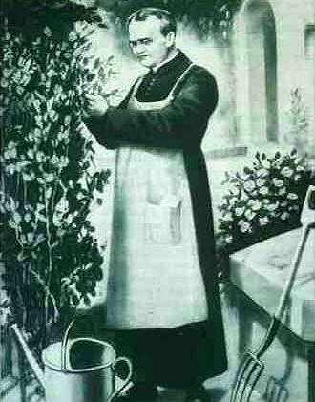
Gregor Mendel (1822-1884)
Responsible for the Laws governing Inheritance of Traits

Slide 5
Gregor Johann Mendel
Austrian monk
Studied the inheritance of traits in pea plants
Developed the laws of inheritance
Mendel's work was not recognized until the turn of the 20th century

Slide 6
Gregor Johann Mendel
Between 1856 and 1863, Mendel cultivated and tested some 28,000 pea plants
He found that the plants' offspring retained traits of the parents
Called the “Father of Genetics”
Work lost in journals for 50 years!

Slide 7
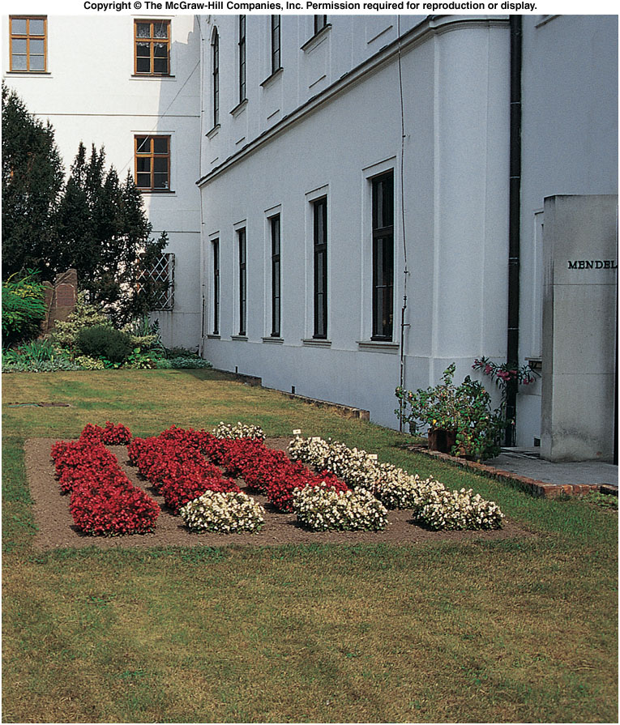
Site of Gregor Mendel’s experimental garden in the Czech Republic
Notes:
Fig. 5.co

Slide 8
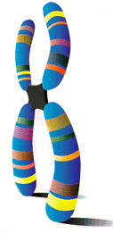
Particulate Inheritance
Mendel stated that physical traits are inherited as “particles”
Mendel did not know that the “particles” were actually Chromosomes & DNA

Slide 9
Genetic Terminology
Trait - any characteristic that can be passed from parent to offspring
Heredity - passing of traits from parent to offspring
Genetics - study of heredity
Alleles - two forms of a gene (dominant & recessive)

Slide 10
Genetic Terminology
Dominant - stronger of two genes expressed in the hybrid; represented by a capital letter (R)
Recessive - gene that shows up less often in a cross; represented by a lowercase letter (r)

Slide 11
Types of Genetic Crosses
Monohybrid cross - cross involving a single trait e.g. flower color
Dihybrid cross - cross involving two traits e.g. flower color & plant height

Slide 12
Genetic Terminology
genotype: total set of alleles of an individual (e.g. RR, Rr, rr)
PP = homozygous dominant
Pp = heterozygous
pp = homozygous recessive
phenotype: the physical feature resulting from a genotype (e.g. red, white)

Slide 13
Punnett process
Here we have some more interesting results: First we now have 3 genotypes
(TT, Tt, & tt) in a 1:2:1 genotypic ratio.
We now have 2 different phenotypes
(Tall & short) in a 3:1 Phenotypic ratio. This is the common outcome from such crosses.

Slide 14
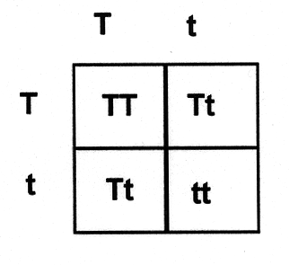
Genetic Practice Problems

Slide 15
Breed the P₁ generation
tall (TT) x dwarf (tt) pea plants
t
t
T
T

Slide 16
Solution:
tall (TT) vs. dwarf (tt) pea plants
t
t
Tt
produces the
F₁ generation
T
Tt
T
Tt
Tt
All Tt = tall
(heterozygous tall)

Slide 17
Breed the F₁ generation
tall (Tt) vs. tall (Tt) pea plants
T
t
T
t

Slide 18
Solution:
tall (Tt) x tall (Tt) pea plants
T
t
produces the
F₂ generation
TT
Tt
T
1/4 (25%) = TT
1/2 (50%) = Tt
1/4 (25%) = tt
t
Tt
tt
1:2:1 genotype
3:1 phenotype

Slide 19
Genotype & Phenotype in Flowers
Genotype of alleles: R = red flower r = yellow flower
All genes occur in pairs, so 2 alleles affect a characteristic
Possible combinations are:
Genotypes RR Rr rr
Phenotypes RED RED YELLOW

