Slide 1
Microscopy Lab
Zannie Dallara

Slide 2
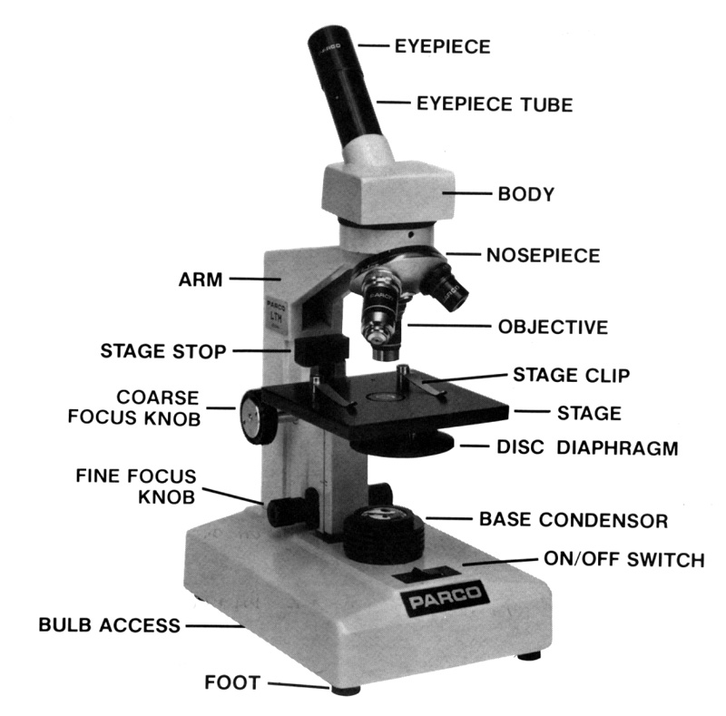
Goal
To see the unseen world & learn to effectively and safely use compound microscopes.

Slide 3
Video: The Hidden World Around Us
http://www.youtube.com/watch?v=9qnMfPkO-1c&feature=related

Slide 4
4x Zoomed-Out
900m X .25 =

Slide 5
10x Zoomed-In
250m X .75 =

Slide 6
* Ocular
* Lenses
*
*

Slide 7
Letter E Zooming In
E
Rule: Keep it centered

Slide 8
Letter E
E
Rule: Find and Focus before you zoom

Slide 9
Wet Mount
Trap Door Method
Goal: minimize bubbles

