Slide 1
Vertebrate Forms and Adaptations: Changes over time
IS 3-4 Vertebrate Biology Unit

Slide 2
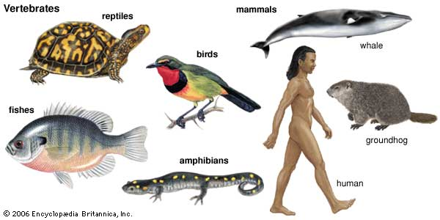
Vertebrate Forms & Adaptations
What is a vertebrate?
A group of organisms with vertebrae
Kingdom: Anamalia > Phylum: Chordata > Subphylum: Vertebrata

Slide 3
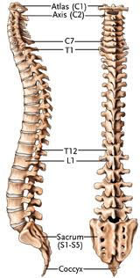
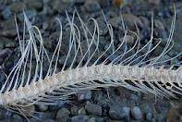
Vertebrae: Why Have them?
Support
Protect the notochord
Anchor Muscles
What is the difference between these two?
What drives those differences?

Slide 4
Evolution of habitats

Slide 5
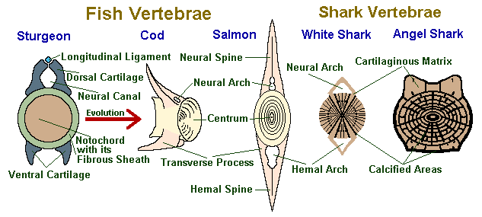
Vertebrates in Water
Forms:
Limbs: Fins
Spine: Uniform Vertebrae, Plain, 2 spines (less muscle attachment)
Why?
Less need for support in water
Different type of movement in water

Slide 6
Vertebrates On Land
Forms:
Limbs: arms, legs, claws, feet, hands… (Why all the variety?)
Spine: Varied Vertebrae in each organism, many spines (more muscle attachment)
Why?
Need support on land
Many types of movement

Slide 7
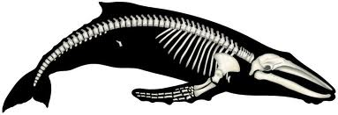
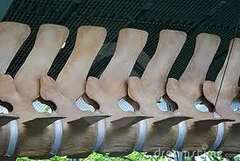
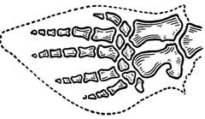
Vertebrates Back to Water
Forms:
Limbs: Fins but look same bones as hands
Spine: Varied Vertebrae in each organism, many spines (more muscle attachment)
Why?
Less need for support in water – but it is hard to lose a feature unless it hurts you to have it (Term: Vestigial)

