Slide 1
Waste and Water Regulation Evolution

Slide 2
Animal’s Urinary and Osmoregulatory systems

Slide 3
Your Goal
Be able to tell the story of kidney evolution as an essay.

Slide 4
Roles of the kidney
excretion
homeostasis
osmoregulation
regulation of salts in the body
regulation of pH
production of a hormone (EPO)

Slide 5
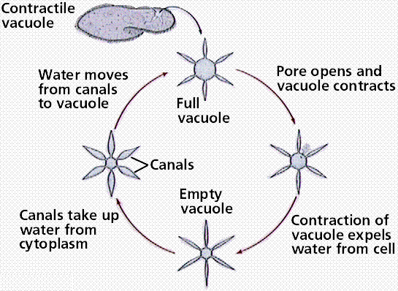
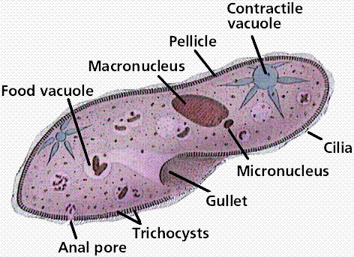
Paramecium
Paramecium live in freshwater and have a problem of water being transported into them because of Osmosis. To ensure they don’t explode they have a contractile vacuole to expel water

Slide 6
Kindney’s Function
Remove Waste from blood:
Salt
Urea
Concentrate Urine (remove water)
Remove Ammonia
Ammonia is neurotoxic. Marked brain damage is seen in cases of failure to to eliminate urea through the kidneys. The result of either of this event is a buildup of circulating levels of ammonium ion.

Slide 7
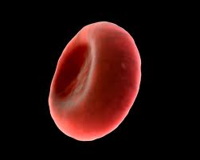
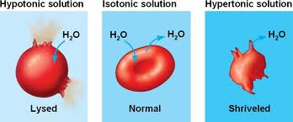
Hypotonic | Isotonic | Hypertonic
Solution
ISOTONIC "ISO" means the same | If the concentration of solute (salt) is equal on both sides -No net movement of water
HYPOTONIC "HYPO" means less | In this case there are less solute (salt) molecules outside the cell -The cell will gain water and grow larger
HYPERTONIC "HYPER" means more | The word, in this case there are more solute (salt) molecules outside the cell -The cell will lose water and shrink

Slide 8
Paramecium
Paramecium live in freshwater and have a problem of water being transported into them because of Osmosis. To ensure they don’t explode they have a contractile vacuole to expel water

Slide 9
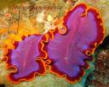
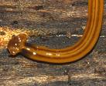
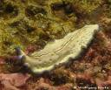
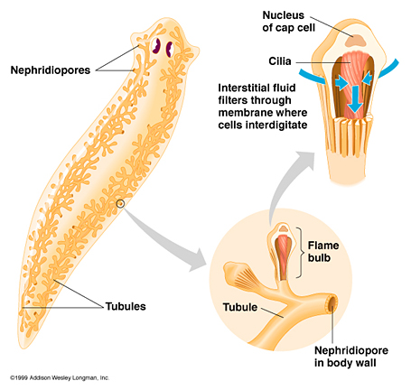
Planaria
Planaria and other flatworms (Phylum Platyhelminthes) live in freshwater.
They have a special excretory system called the flame cell, which is the simplest animal that has a dedicated excretory system. The beating of these cilia resemble a flame, giving the cell its name.

Slide 10
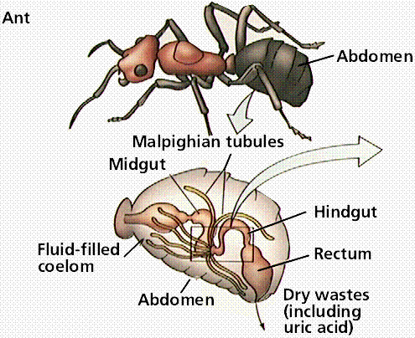
Insects
The Malpighian tubule system is a type of excretory and osmoregulatory system found in Insects.
The system consists of branching tubules that absorbs solutes, water, and wastes from the hemolymph (there version of blood). The wastes then are released in the form of solid nitrogenous compounds

Slide 11
Evolution of the Kidney

Slide 12
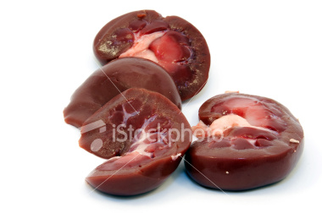
Evolution of the Kidney
Only the Birds and mammals can reabsorb enough water from the filtrate to produce urine that is hypertonic to blood (more concentrated than blood)

Slide 13
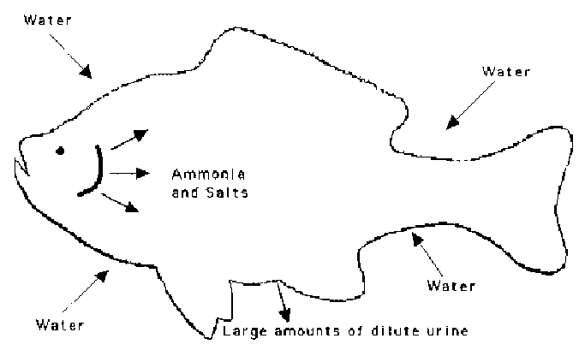
Kidneys and Freshwater Fish
Fish rely heavily on their gills for excreting ammonia. (Nitrogen waste)
evolved 1st in freshwater fish (bony fish)
Problem 1- Water enters the body from the environment
Problem 2- Solutes (particles) tend to leave the body to enter the environment

Slide 14
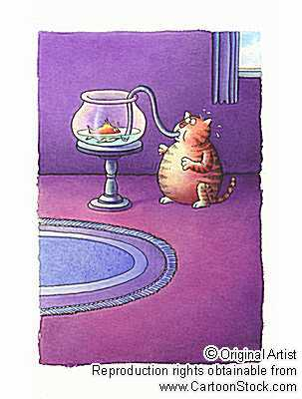
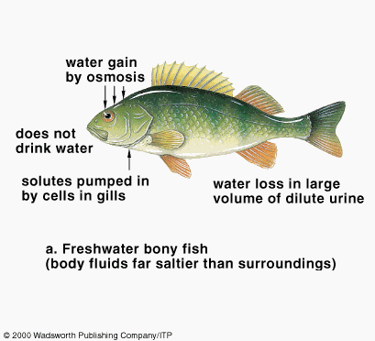
Freshwater fish
Solution
Freshwater fish DON’T drink water
Freshwater fish actively reabsorb ions across the nephron from the filtrate into the blood

Slide 15
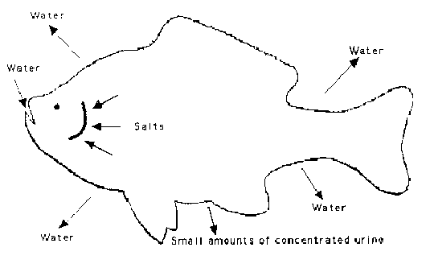
Saltwater fish (Marine bony fish)
Saltwater fish probably evolved from freshwater fish.
Direction of water, ammonia, and salt movements into and out of saltwater fish. Saltwater fish drink large amounts of water and excrete small amounts of concentrated urine.

Slide 16
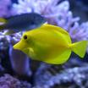
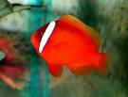
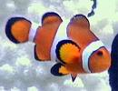
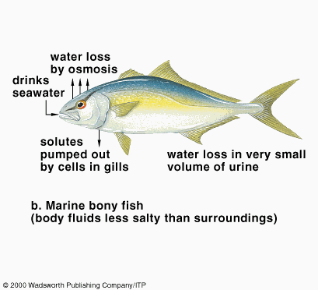
Saltwater Fish
Solution
Gills actively secrete NaCl that is being absorbed from the water
Fish DRINK water and produce very little urine

Slide 17
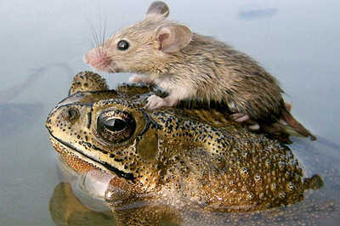
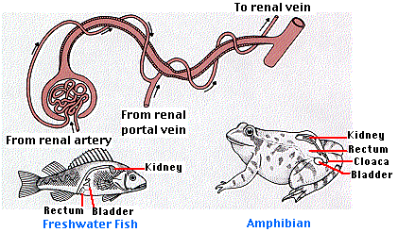
Amphibians
Contraction of its heart provides the pressure to force the water and ions into the glomerulus as nephric filtrate.
Most of the nitrogenous wastes (including large amounts of ammonia, NH₃) leave by diffusion out of the gills.
So, the kidney is mostly a device for maintaining water balance in the animal, rather than an organ of excretion.
Identical to kidney of freshwater fish.
Not surprisingly they spend a lot of time in freshwater and produce very diluted urine and actively transport Na⁺ in across the skin

Slide 18
Amphibians

Slide 19
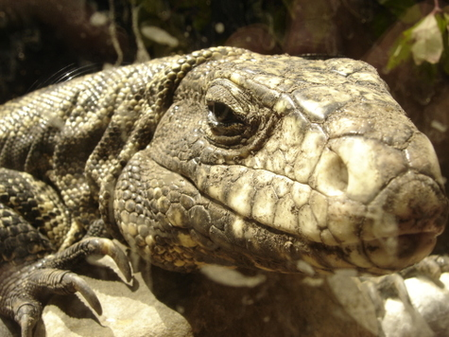
Terrestrial (Land) Reptiles
Many reptiles live in dry environments (e.g., rattlesnakes in the desert). Among the many adaptations to such environments is their ability to convert waste nitrogen compounds into uric acid.
Their nephrons helping to conserve
Some have the ability to convert waste nitrogen compounds into uric acid.
Reference

Slide 21
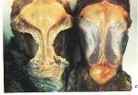
Birds
Since birds are a descendent of the reptiles they have a very similar excretory system
Some birds drink saltwater when fishing and have a salt gland, located just above the bill, filters out much of the salt before it gets to the kidneys.

