Slide 1
Forms of Animal Communication
By Sam Robinson
&
Zannie

Slide 2
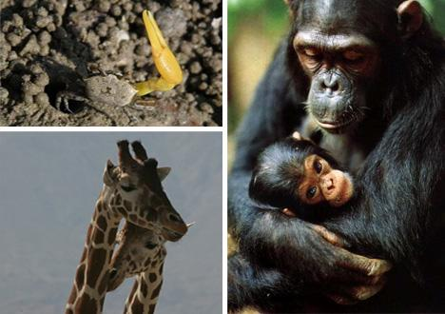
Animals communicate:
Purposes
Alerting other members of the species of danger,
to asking another member for help,
Simply conversing.
Forms of communication:
gestures,
facial expressions,
gaze,
vocalization,
olfactory communication,
bioluminescence,
electrocommunication.

Slide 3
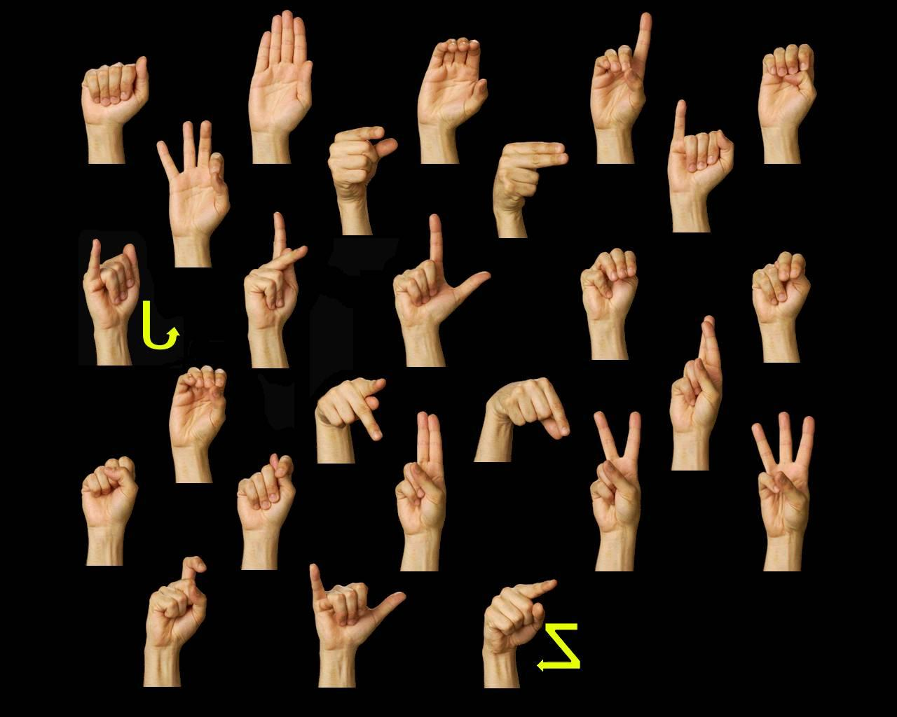
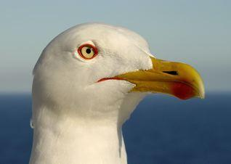
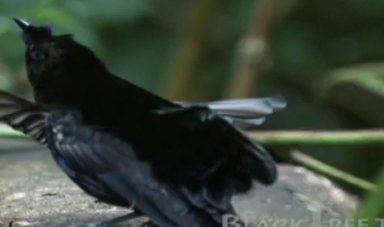
Gestures
This form of communication is one of the best known forms, and involves the display of:
distinctive body parts
movements,
Often occurring in combination to convey a message.
For example, a young seagull will tap their parent's red spot on the bill when they want food.

Slide 4
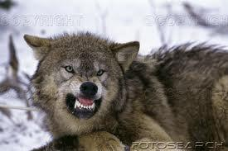
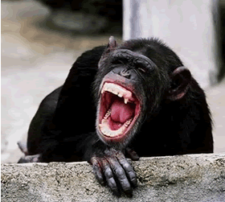
Facial Expressions
Different animals have different ways of conveying emotion through facial expressions, however, some ones are found throughout different species. For example, showing one's teeth is a common sign of anger.

Slide 5
Gaze
Although not commonly used for detailed communication, it is often a very useful form for trying to draw another species member's attention to something. It can also be used for competing males, for the first to back down is often considered weaker.
To avoid direct competition

Slide 6
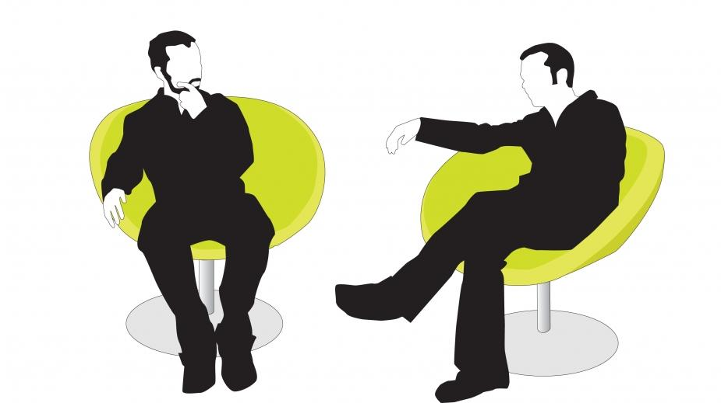
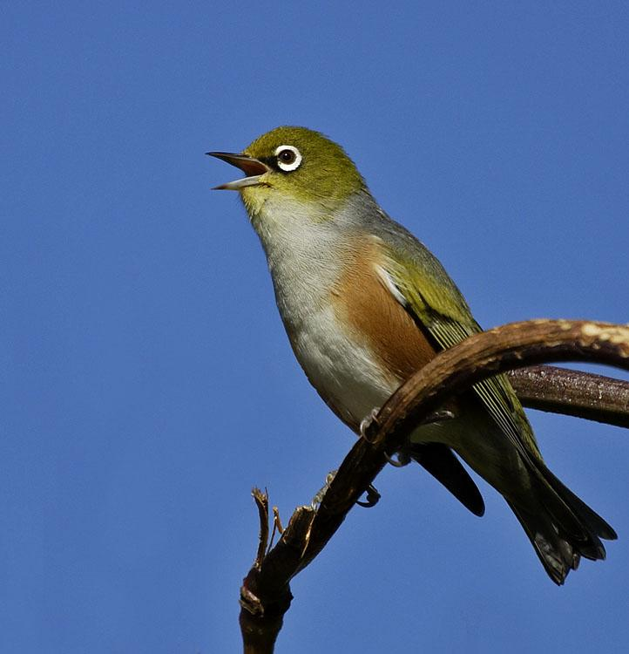
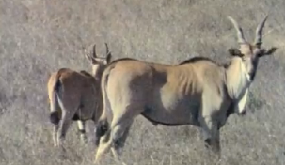
Vocalization
Perhaps one of the most common among higher intelligence animals, this form is most commonly found among humans. The very fact that we have actually created complex languages using sounds is incredible when one thinks about it. Among animals, it can be used for warning calls and attracting a mate.

Slide 7
Olfactory Communication
Most commonly found among animals that have a "hive mind," such as ants and termites, this form of communication involves the use of pheromones and scents to convey messages. Cats have specialized glands that they use to "scent" things.

Slide 8
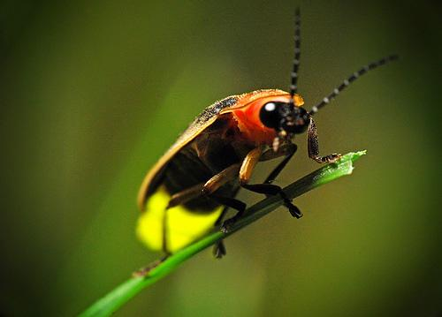
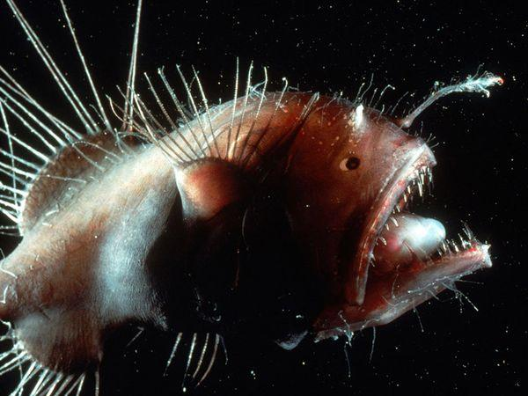
Bioluminescence
Most commonly found among places that lack light, this form of communication involves biologically generated lights. Most commonly known among fireflies, this way of communication is common in the depths of the sea.
TED talk

Slide 9
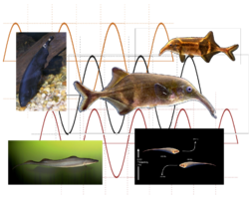
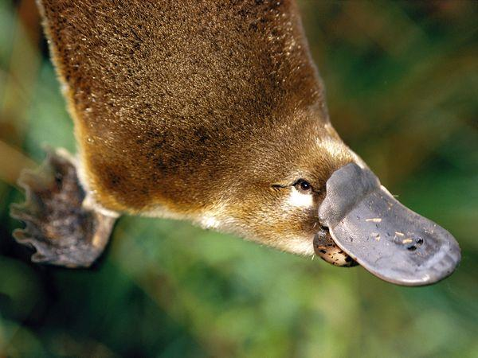
Electrocommunication
The least common form of communication, this form involves conveying messages through the form of electric signals. It is commonly found among aquatic life, but some mammals, such as the platypus and echidna, are hypothetically able to do it.
Lateral Line

