Slide 1
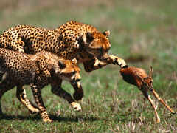
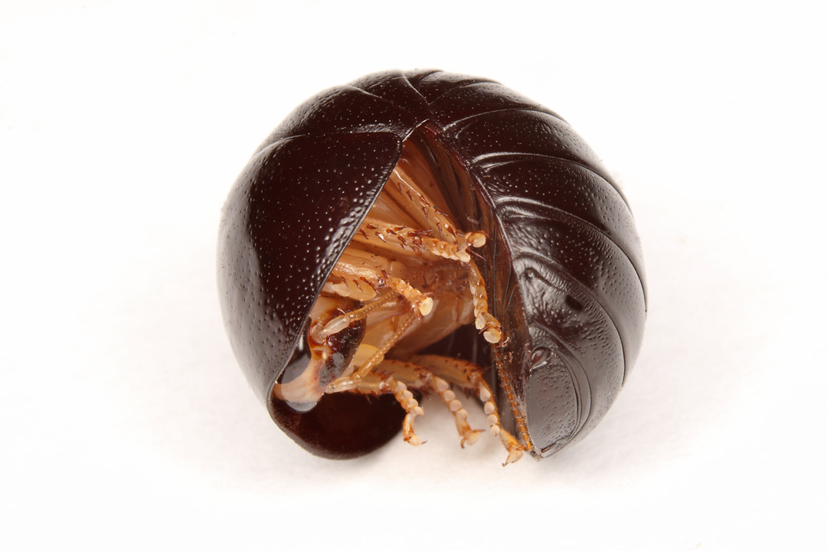
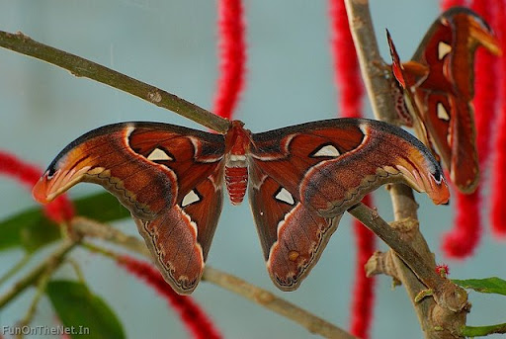
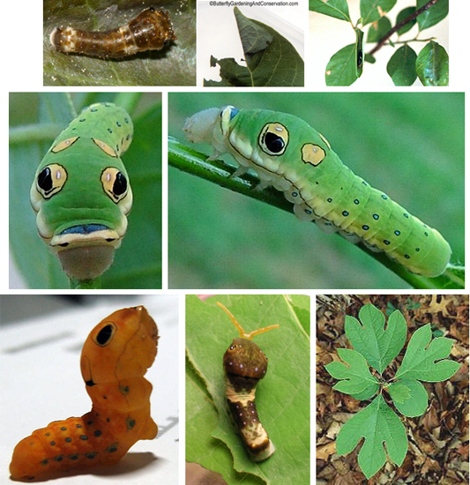
Avoiding Predation
Main content from:
http://iweb.tntech.edu/cabrown/AnimBehav/4230AntipredatorBehavior.pdf

Slide 2
Two Ways to Avoid Getting Eaten
Predator avoidance behaviors remove animals from being perceived by predators
For this to evolve, encounters with predator should lead to strong decrease in prey survival
Antipredator behaviors allow animals to survive once they’ve been perceived by a predator
For these to evolve, behavior should lead to increased survival after detection
Thus, both ultimately require some degree of encounter with predators
Most animals have both types of behaviors in their behavioral repertoire

Slide 3
Stages of Encounters
Prey can enhance survival at 4 distinct stages…
Avoid detection by predator
Avoid attack by predator once detected
Avoid capture by predator once attacked (or pursued)
Avoid consumption by predator once captured

Slide 5
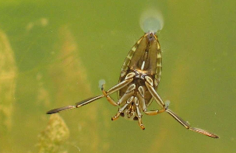
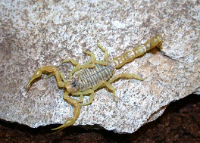
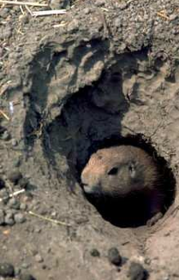
Predator Avoidance Methods I
Hiding in a refuge
May be a burrow, crevice, nest, under rock, in sediment, etc.
Using areas where predator does not occur
Predator may not occur ever in that area, or not occur at some times in that area, or not be active when prey is
Example 1: Buthus occitanus scorpions are less active when moon is full (more easily seen by predators
Example 2: juvenile Notonecta hoffmanni water boatmen avoid areas with cannibalistic adults
Forage in lower quality parts of pond

Slide 6
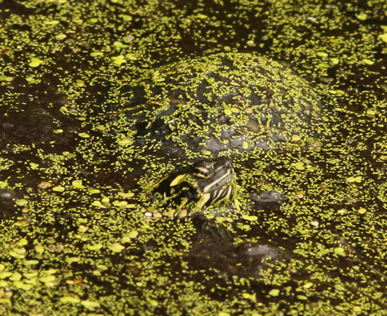
Predator Avoidance Methods II
Prey may exhibit crypsis, or background matching
Morphological adaptations that allow animal to blend into background
May match color, appearance, or both Clockwise from
Often have behavioral adaptations enhance cryptic appearance
Occurs when prey is active at same time and same area as predator

Slide 8
Predator Avoidance Methods III
Prey may avoid providing appropriate sensory signals to predator
Remain silent (for auditory hunters)
Do not release chemicals
Avoid movement (for visually or vibration sensing hunters)
Prey may exhibit distracting behaviors to enable other (usually related) individuals to remain undetected
Mobbing behavior in some birds and social mammals
Done to distract predator from eggs or young

Slide 9
Mobbing

Slide 10
Avoiding Attack Once Detected
Animal may use a variety of protective mechanisms
Claws, quills, stingers, horns, urticating hairs
Toxins, noxious compounds, sprays, stickysecretions
Large size, fast speed, armor
Here, the mechanisms will deter predator from attacking
Often advertise noxious or toxic defenses (that are hidden from predator’s view) with aposematic (or warning) coloration
Prey may also perform behaviors to advertise defenses
Examples include tail-flagging and stotting

Slide 11
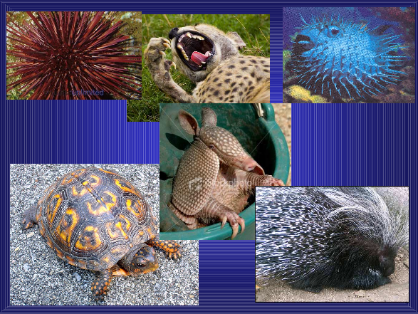

Slide 13
Avoiding Attack Once Detected
Animals that are not dangerous may exhibit mimicry of other animals that are
There are two individuals/species
Model is always toxic, noxious or dangerous
Mimic may or may not be toxic or dangerous
Mimic often strongly resemble model in appearance
Some mimics bear less resemblance except for certain body parts or when in certain positions
Still others mimic sounds or scents of model

Slide 14
Batesian Mimicry “Bats aren't dangerous, but people think they are”
Model is toxic/dangerous, mimic is not
Mimic benefits from this, model does not
However, mimic only benefits if it is relatively rare compared to model
If mimic too common, predator encounters it too frequently and doesn’t learn to avoid this type of prey
Harms both mimic and model

Slide 16
Müllerian Mimicry
Both individuals/species are toxic or dangerous
Both species benefit from this
Predator will learn to avoid both when eating either one
Selection should lead to increased similarity
Once thought to be much less common than Batesian mimicry, but may be equally common

Slide 19
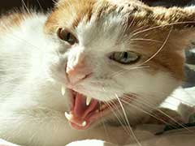
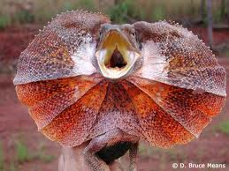
Avoiding Capture Once Attacked
Use the defensive attributes (sprays, quills, stings, goo, armor, etc.) as protection
Flee (run away)
Fight back against predator
This can also include performing threatening behaviors that deter predator (bluffing)

Slide 20
Spray

Slide 21
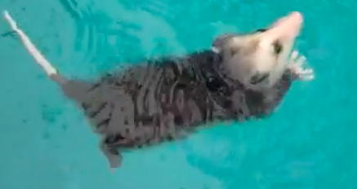
Avoiding Consumption Once Captured
Play Dead
Lay dead (thanatosis)
Often slows intensity of predator attacks

